Slide 1


AIML
PBL | AI3170
Smart City Utility Management System
FixMyCity
Project Guide
Dr. Yadvendra Pratap Singh
Submitted By
Khushi Madan, Avneet Singh Oberoi and Jatinpreet Singh
School of Computer Science & Engineering
Department of Artificial Intelligence and Machine Learning
Manipal University Jaipur, India
March 2025

Slide 2
Table of Contents
Problem Statement
Introduction
Objective
Methodology
Tools
Features
Scope
Target Audience
Prototype
BETA Version of Application

Slide 3
Problem Statement
The current manual system for reporting issues like
Garbage collection
Street light maintenance
Stray Dogs
Water Logging
is inefficient leading to delays and reduced public satisfaction

Slide 4
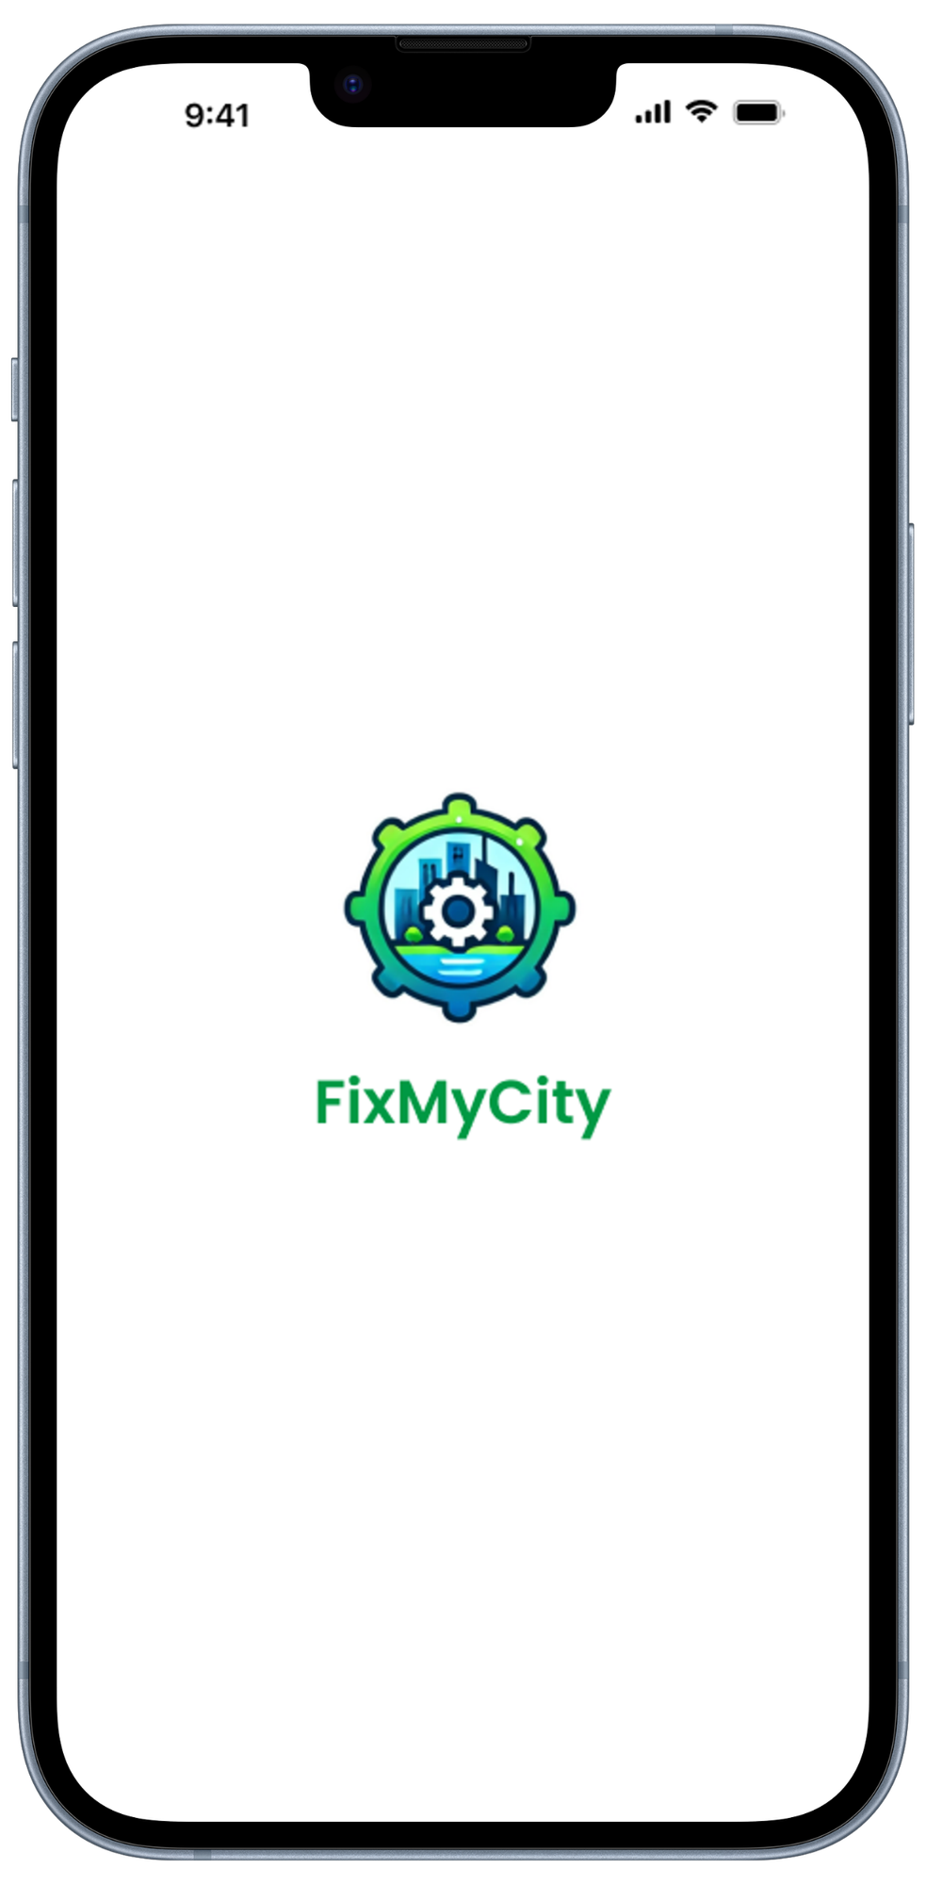


Our Solution – FixMyCity Application
- Making Urban Spaces Smarter and Cleaner

Slide 5
Introduction
FixMyCity is designed to empower citizens by providing a seamless platform to report civic issues. This app allows users to easily register complaints by uploading images and details of the affected areas, ensuring that local authorities can quickly identify and address these problems. By enabling real-time tracking and updates on the status of their complaints, the app fosters transparency and accountability, contributing to the overall development and improvement of urban infrastructure. This solution aims to create smarter, safer, and more sustainable cities for all residents.

Slide 6
Objective
Provide a platform for residents to report city infrastructure issues
Quick fixes and updates to their complaints
Automate resource allocation using Machine Learning
Increase transparency and accountability in resolving complaints
Foster a cleaner, safer and more organized urban environment
Easier for authorities to keep a check on all the complaints and making sure complaints are resolved before closing

Slide 7
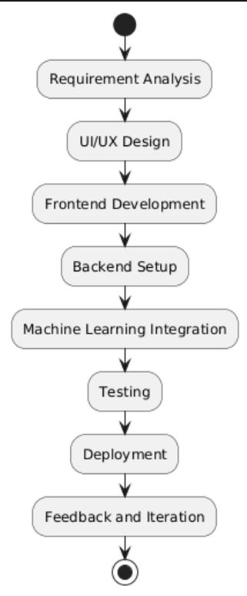
Methodology

Slide 8
Methodology
1. Requirement Analysis
Identify app features (user login, complaint logging, admin dashboard)
Tools : Figma (UI/UX Design)
2. UI/UX Design(Prototype Creation)
Design interactive screens for users and admins
Tools: Figma

Slide 9
Methodology
3. Frontend Development
Build the app interface using Flutter
Use Dart for implementing interactive features
4. Backend Setup
Use Firebase Firestore for database management
Use Firebase Storage for image storage
Implement Firebase Authentication for secure login

Slide 10
Methodology
5. Machine Learning Integration
Train an ML model using TensorFlow to estimate workforce requirements based on complaint photos
Test ML accuracy with sample data
6. Testing
Perform unit testing for individual modules (e.g. login, photo upload)
Conduct integration testing to ensure all components work together
Tools: Flutter testing libraries

Slide 11
Methodology
7. Deployment
Host the app using Firebase Hosting (if needed for web) or deploy on play stores and app stores
Integrate GitHub for version control
8. Feedback and Iteration
Gather feedback from test users
Refine the app based on input

Slide 12
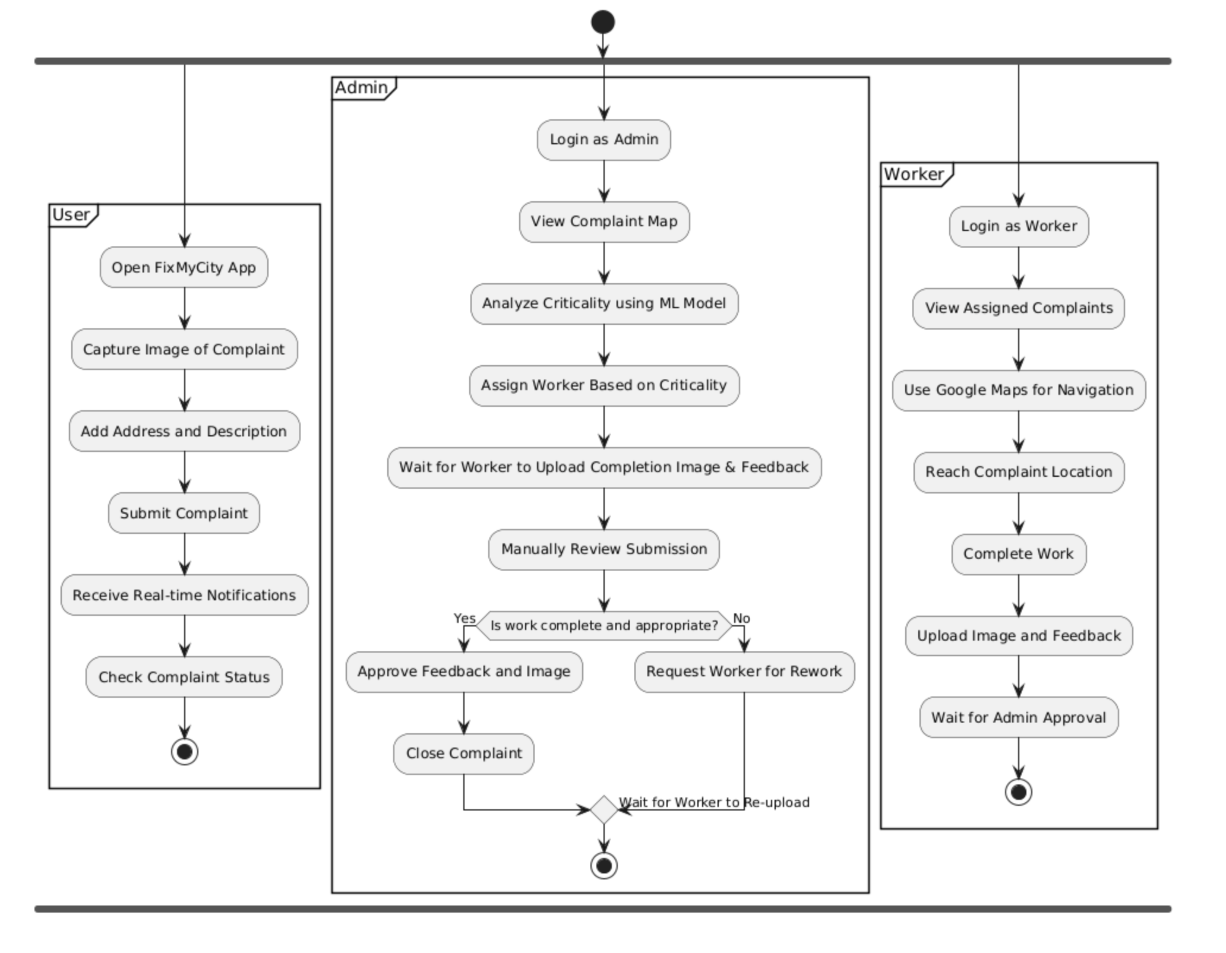
How FixMyCity works?

Slide 13
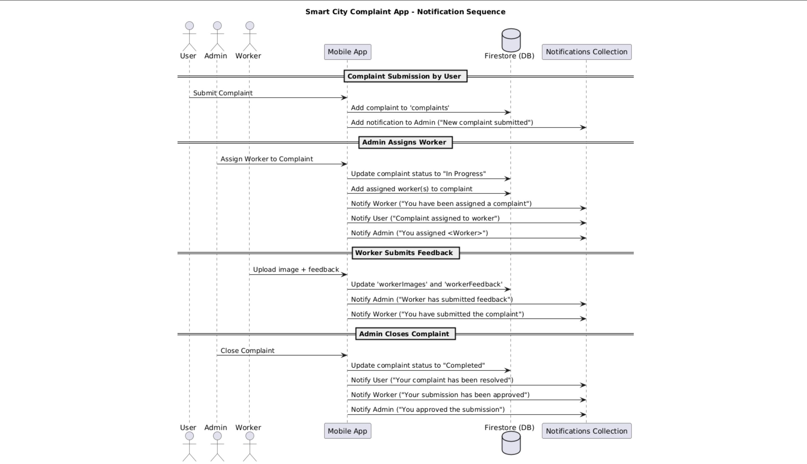
How FixMyCity works?

Slide 14



Tools
Flutter : Frontend
Tensorflow : MobileNetV2 model for prediction of criticality of any complaint
Firebase: Backend, analytics, cloud-based storage, and potentially updating the ML model dynamically if needed

Slide 15

Features
Key features of our application are –
For Users:
Register and log complaints with photo attachments
Real-time complaint status updates
Easy tracking of issue resolution

Slide 16
Features
Key features of our application are –
For Administrators:
Receive and manage complaints
Assign complaints to workers
Mark complaints as resolved only after verification

Slide 17
Features
Key features of our application are –
For Workers:
Receives the task assigned.
Resolve the complaint and submit photo and feedback.
Mark complaints as resolved only after verification

Slide 18
What makes our app DIFFERENT?

Slide 19
Unique Features
1. Multi-Role Dynamic Workflow
Seamlessly integrates Users (Citizens), Workers, and Admins within one unified platform.
Each role gets a customized interface and set of functionalities.
2. Complaint Submission with Real-Time Geotagging
Automatically fetches and logs the user's current location for complaints.
Makes it easier for workers to find the issue spot on ground using Google Maps API providing them directions to reach the site of complaint.

Slide 20
Unique Features
3. Visual Proof-Based Resolution
Every worker uploads work completion images and feedback as proof.
Ensures transparency and visual accountability.
4. Role-Based Notifications System (Firestore-powered notification system with time-stamps)
Users get notified on complaint status updates as well as the name and number of worker assigned to their complaint for easy tracking.
Workers get notified when complaints are assigned and approved by the admins.
Admins get alerts when feedback and image is submitted by a worker and when they assign complaints to workers.

Slide 21
Unique Features
5. Real-Time Status Tracking
Users and admins can see complaint status change live:
Pending → In Progress → Completed
6. Admin Feedback Validation
Admin can review worker submissions (image + feedback) as well as Criticality of the complaint calculated by our ML model before closing a complaint.
Manual approval ensures quality and control.

Slide 22
Unique Features
7. Firestore-Driven Modular Data Architecture
Complaint details, images, and feedback are stored under structured fields like:
workerFeedback
userId
workerId

Slide 23
Scope
Where can this be applied?
Urban city management systems
Residential societies and gated communities
Industrial zones and public spaces
Integration with municipal corporations’ existing platforms

Slide 24
Target Audience
Urban residents looking for quick solutions to daily issues
Municipal corporations aiming for efficient resource management
Contractors and workforce teams responsible for on-ground work
Environmental organizations tracking urban cleanliness initiatives

Slide 25
BETA VERSION OF APPLICATION

Slide 26
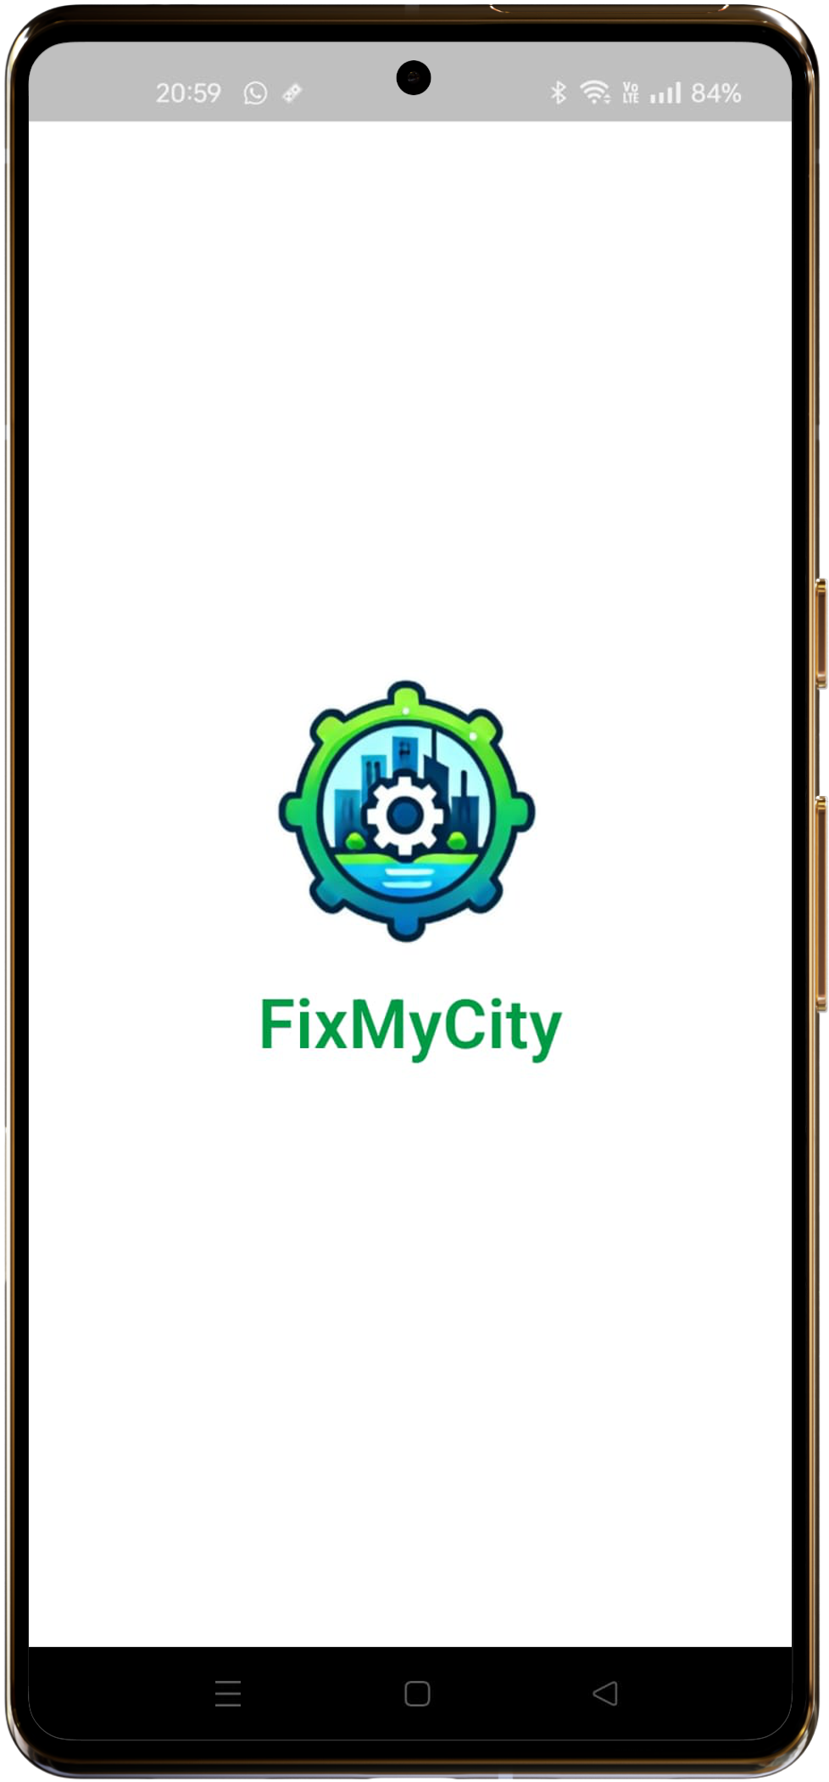
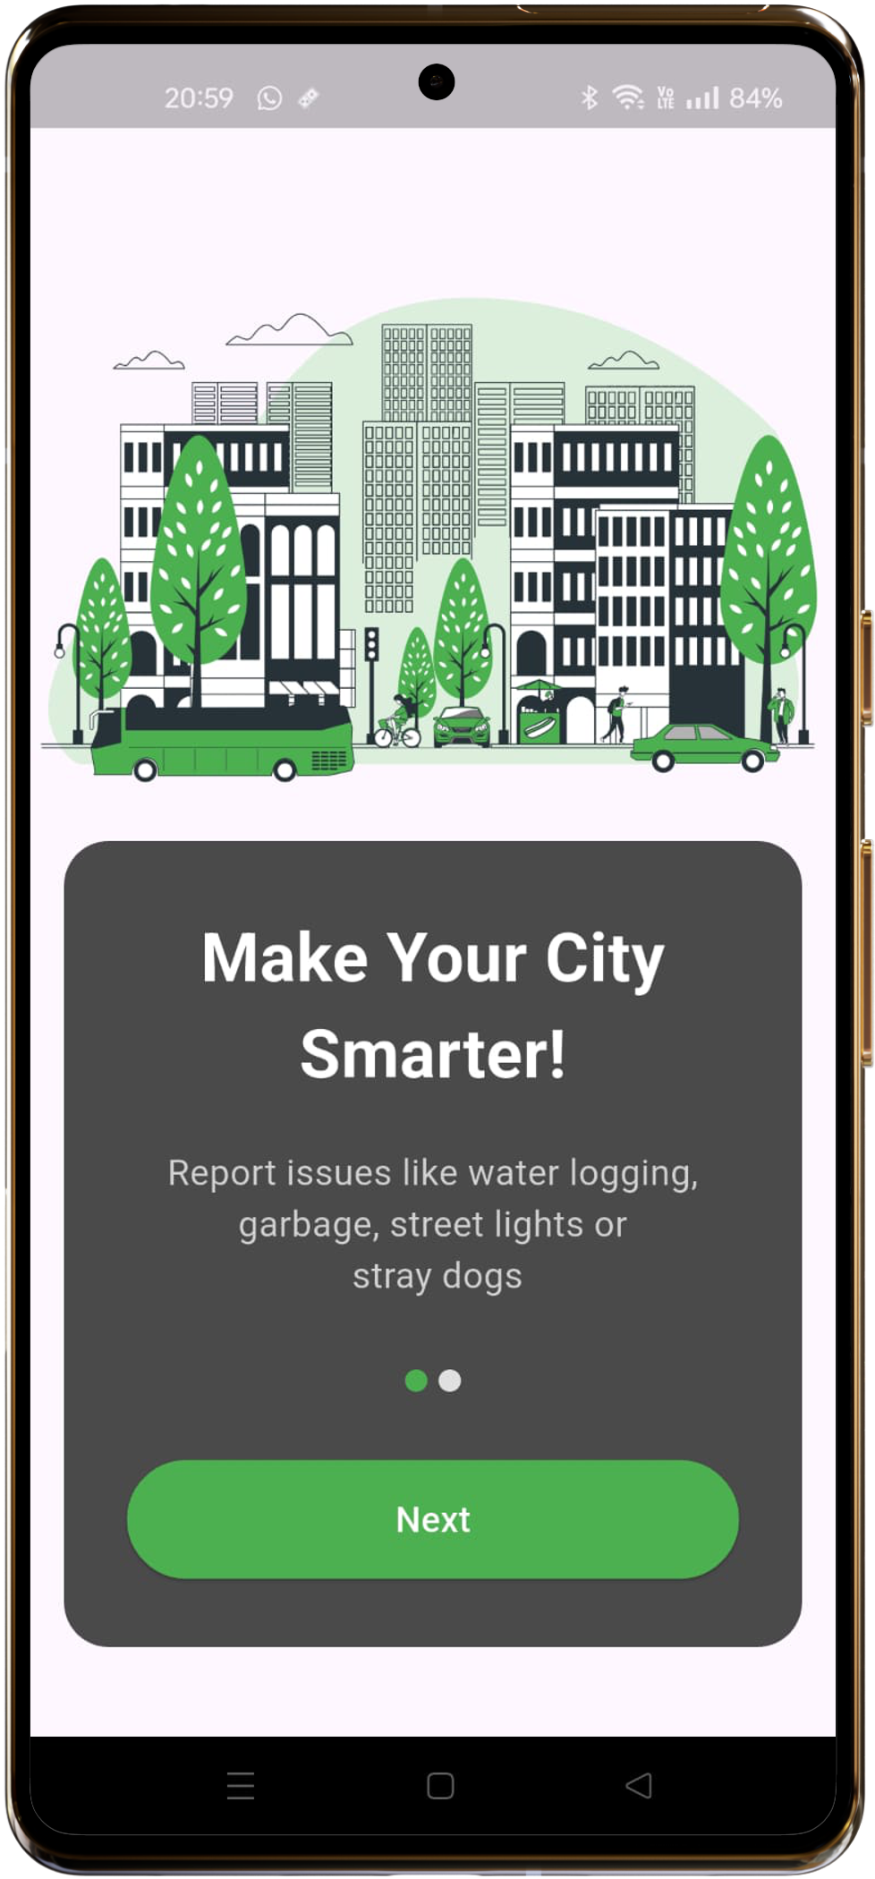
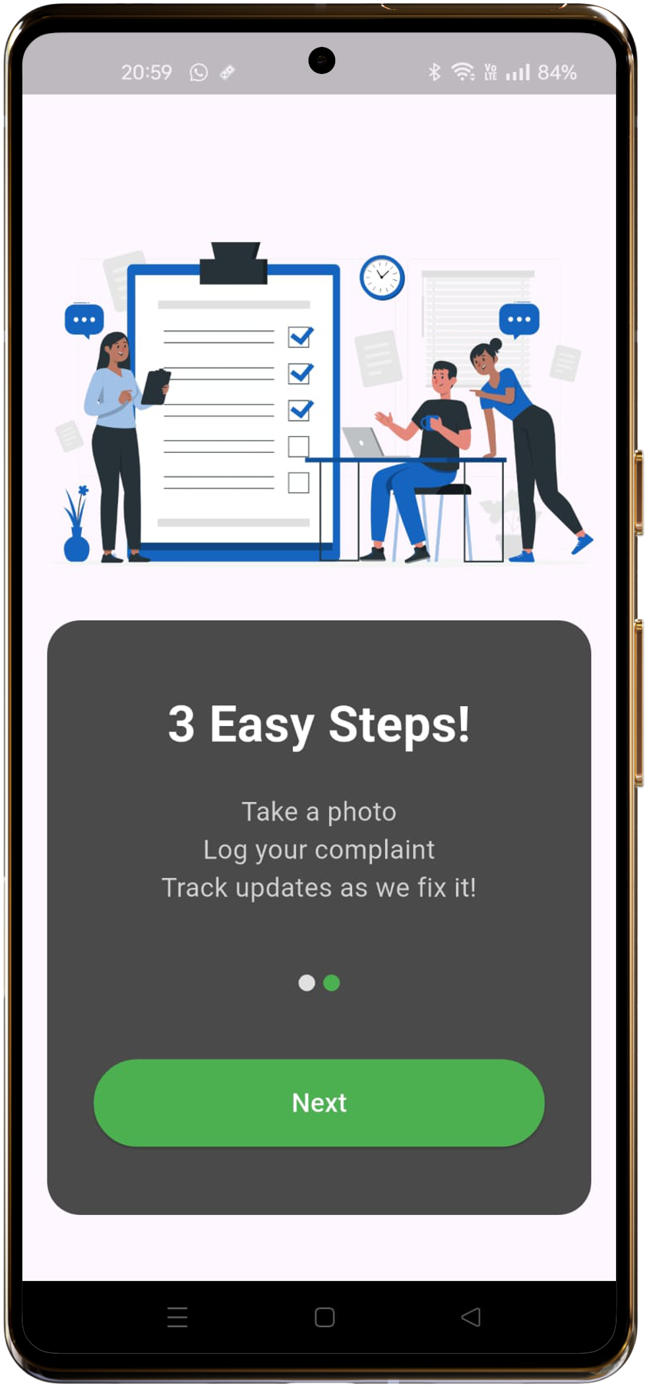
Onboarding Screens

Slide 27
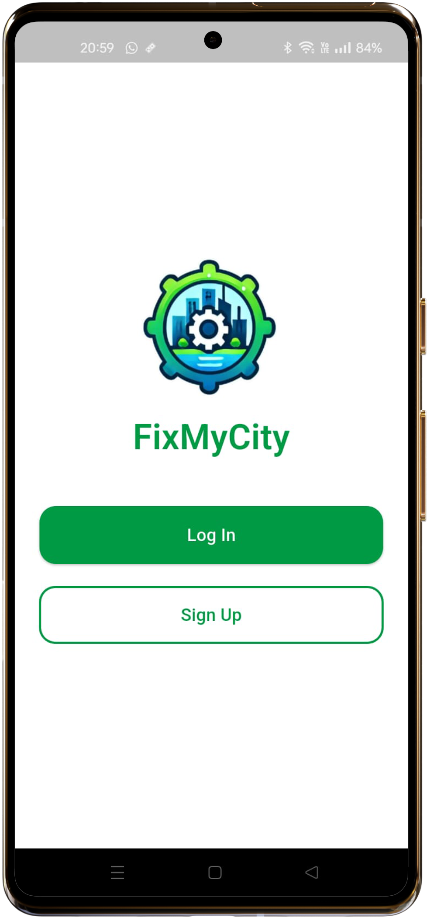
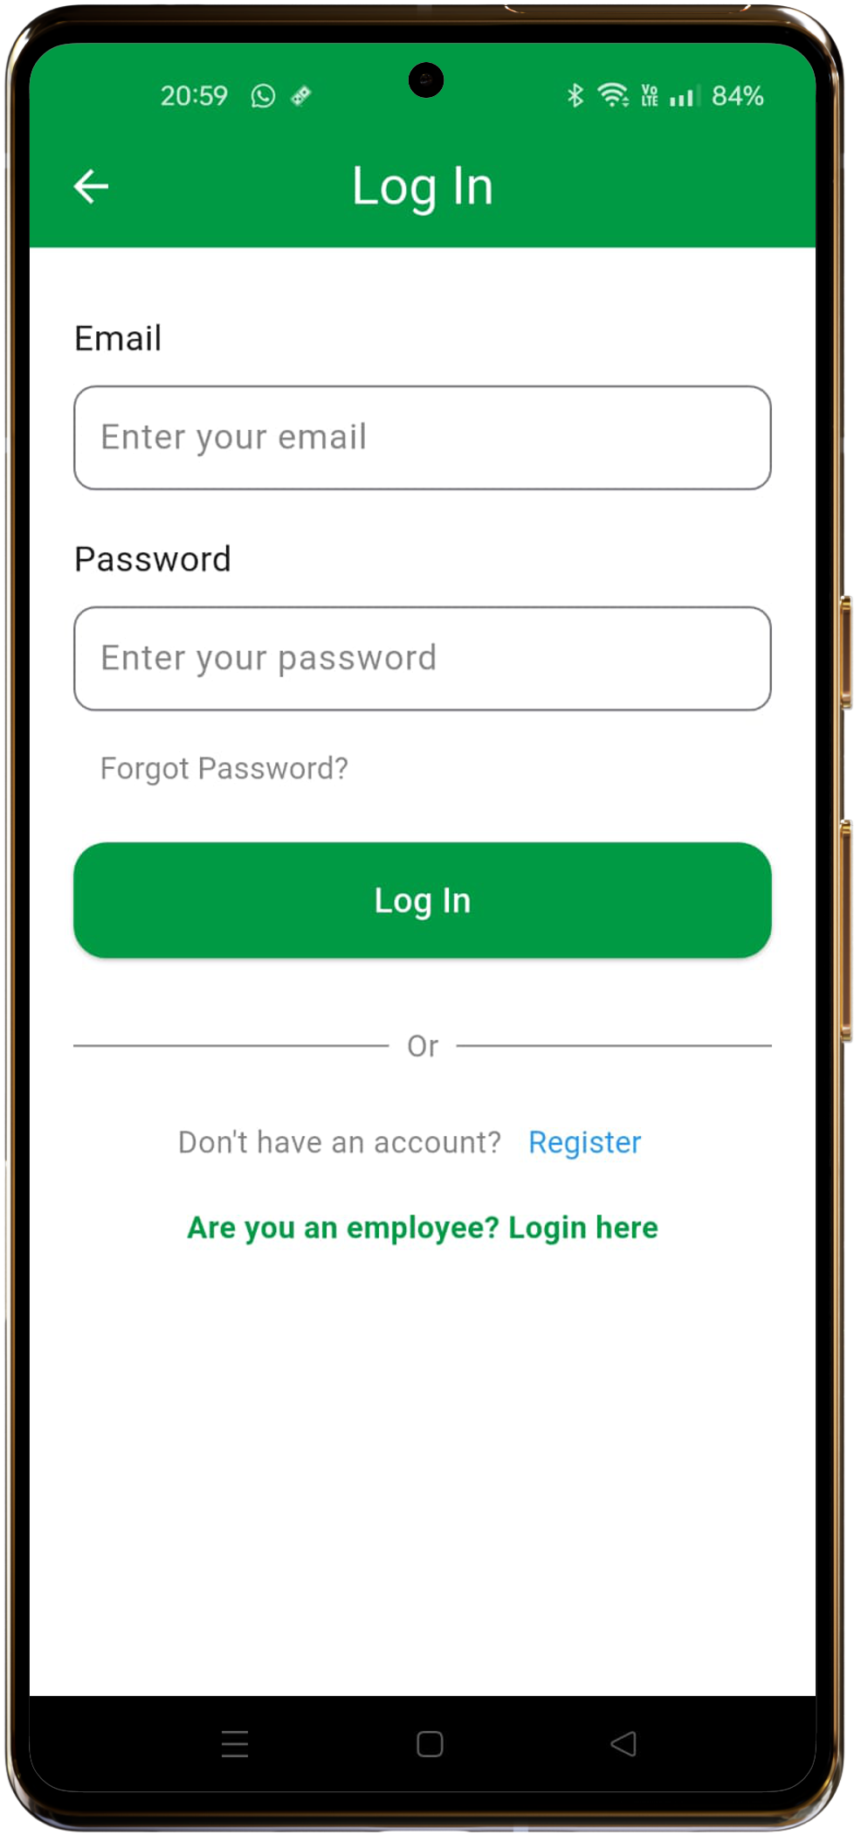
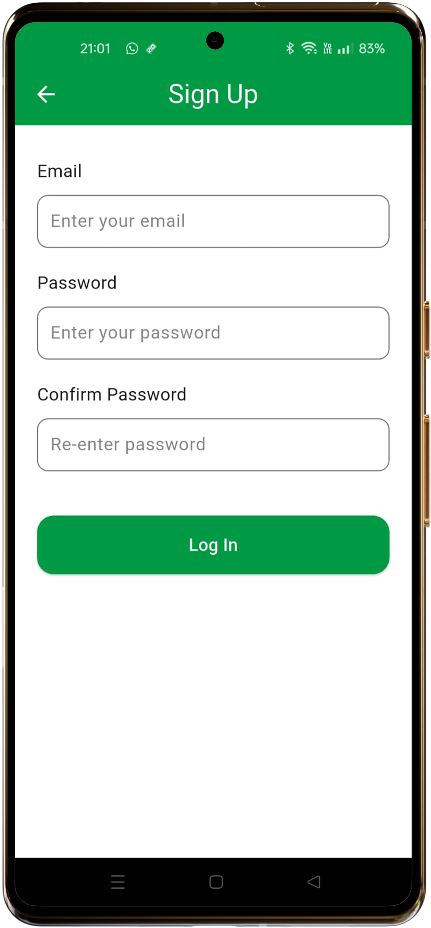
Log In/Sign Up Screens

Slide 28
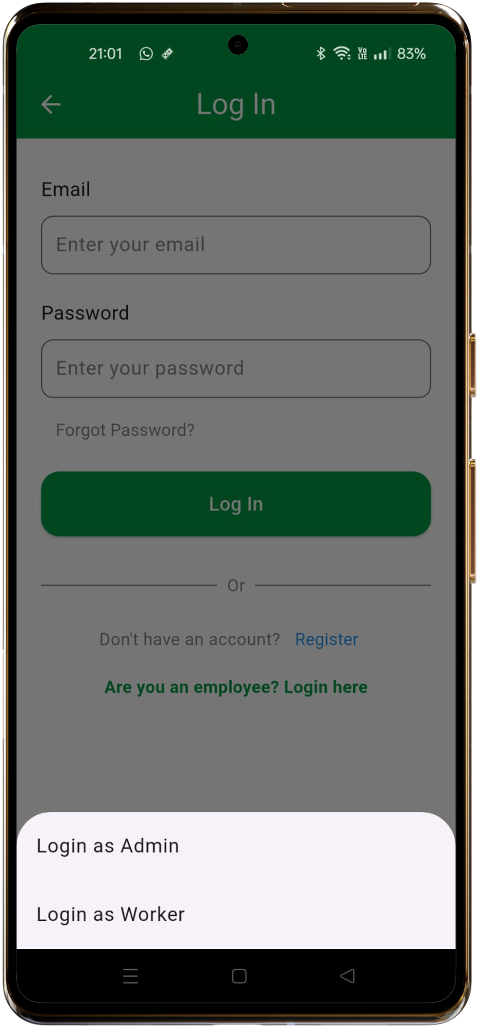
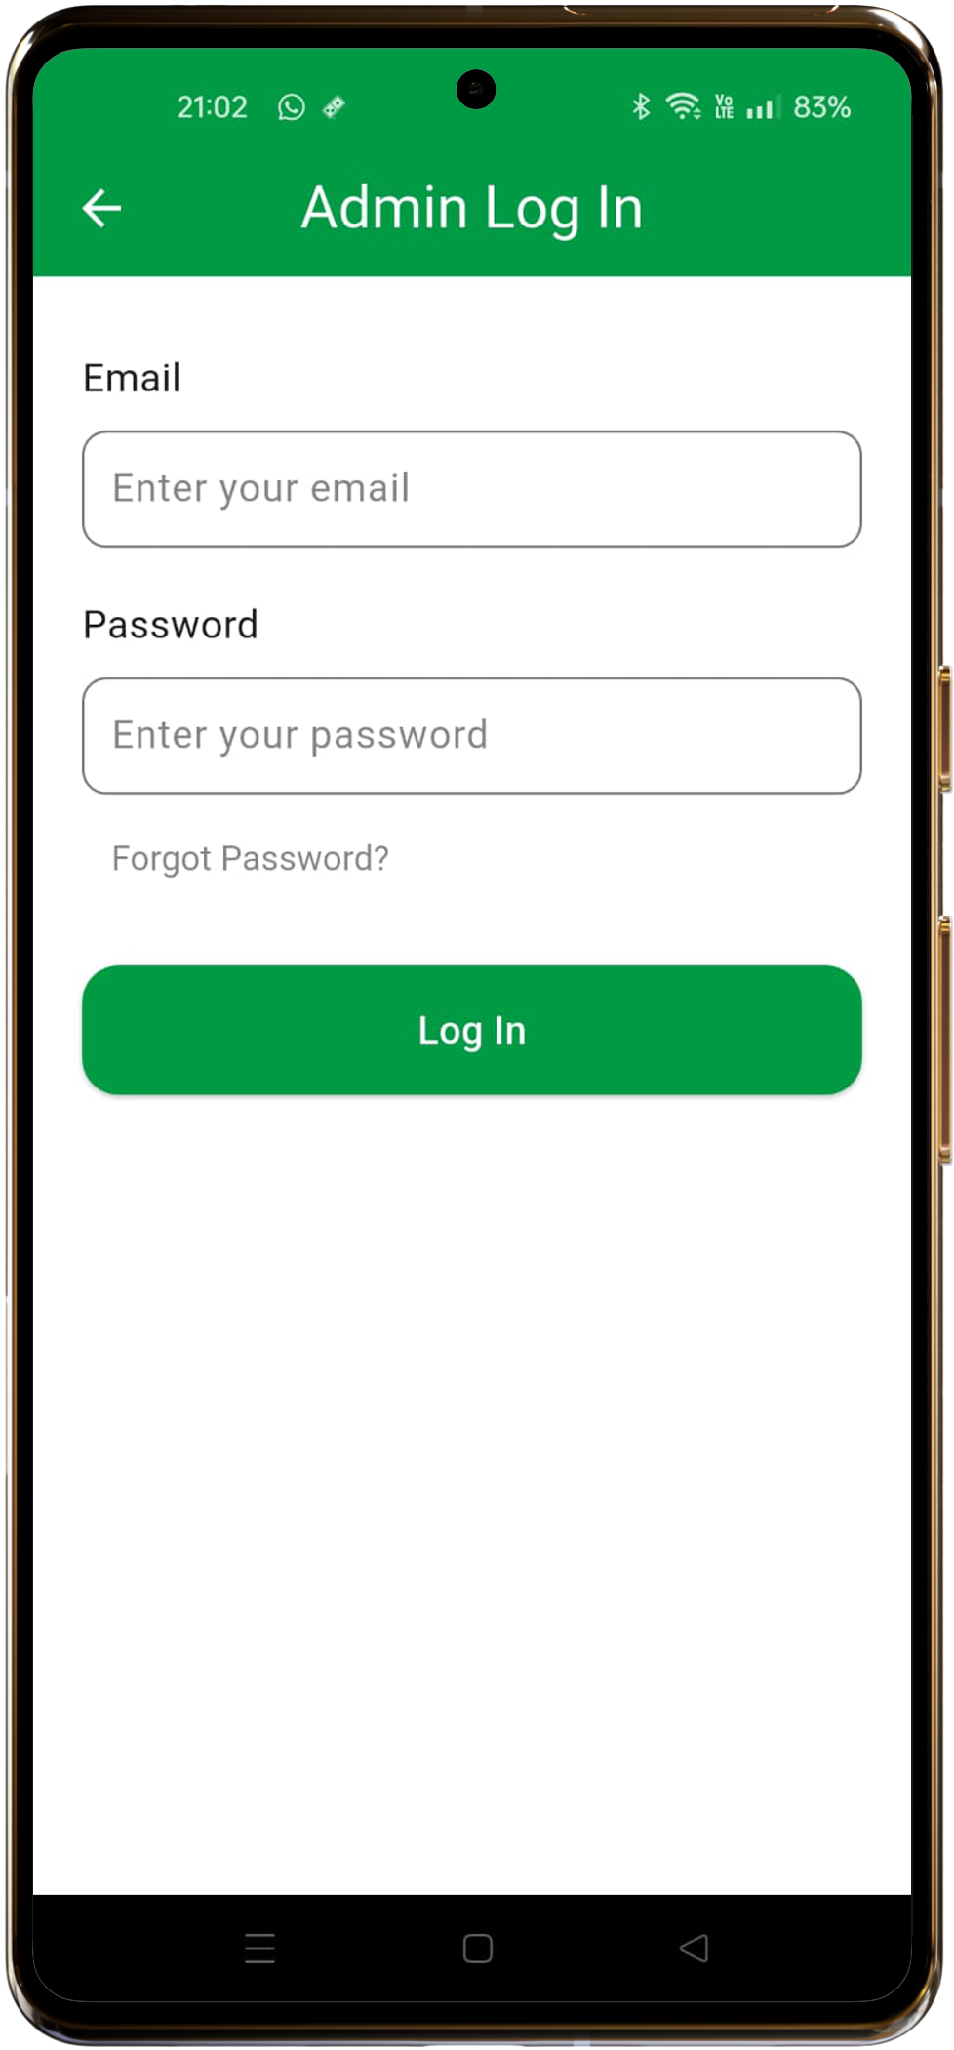
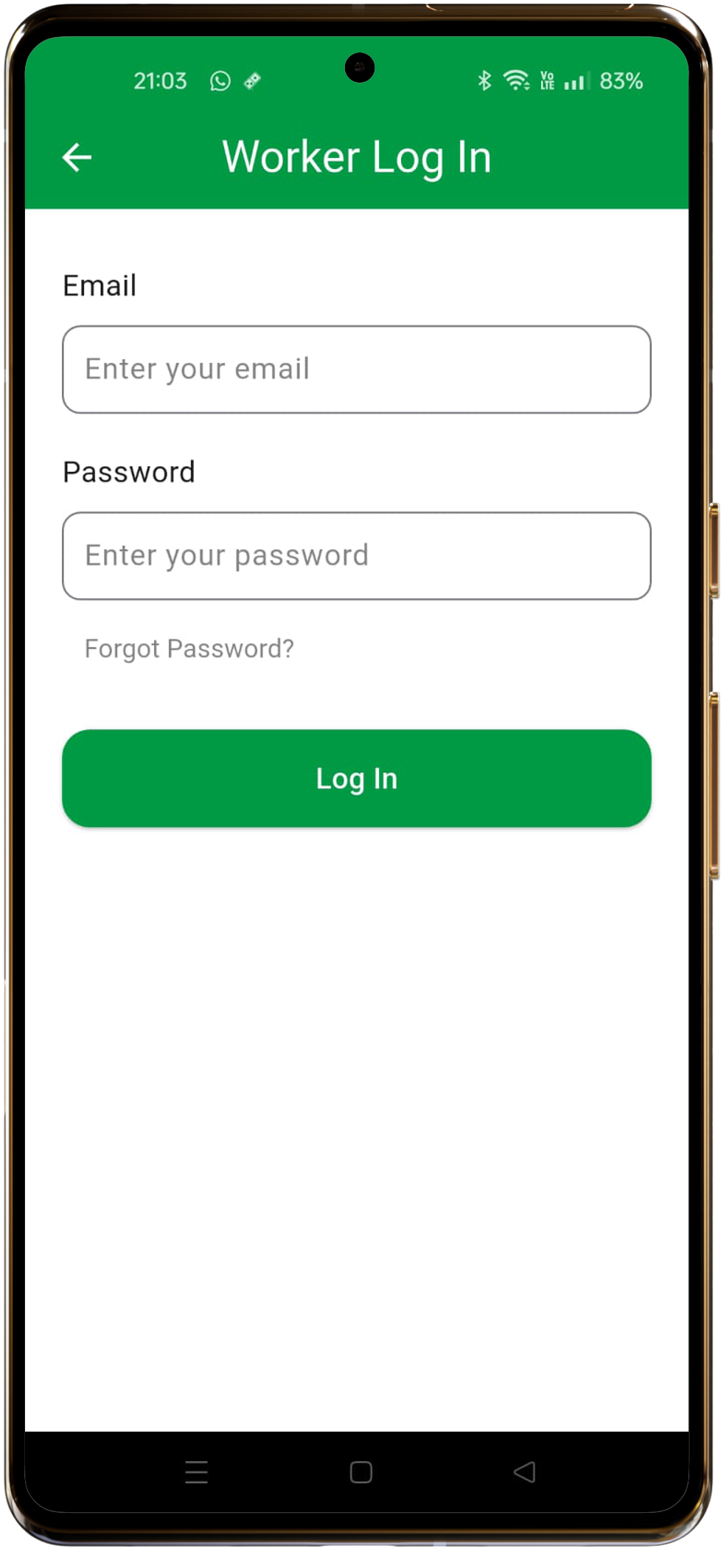
Log In/Sign Up Screens

Slide 29
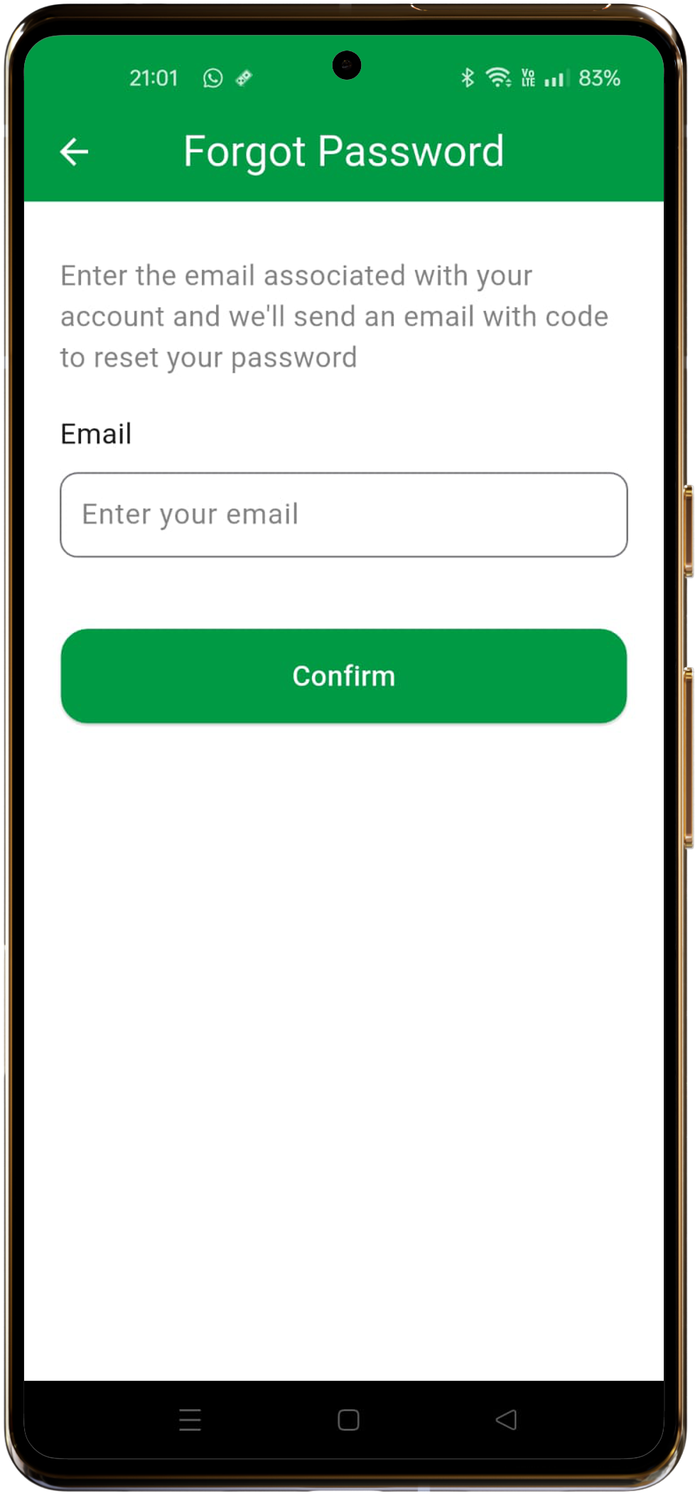
Forgot Password Screen

Slide 30
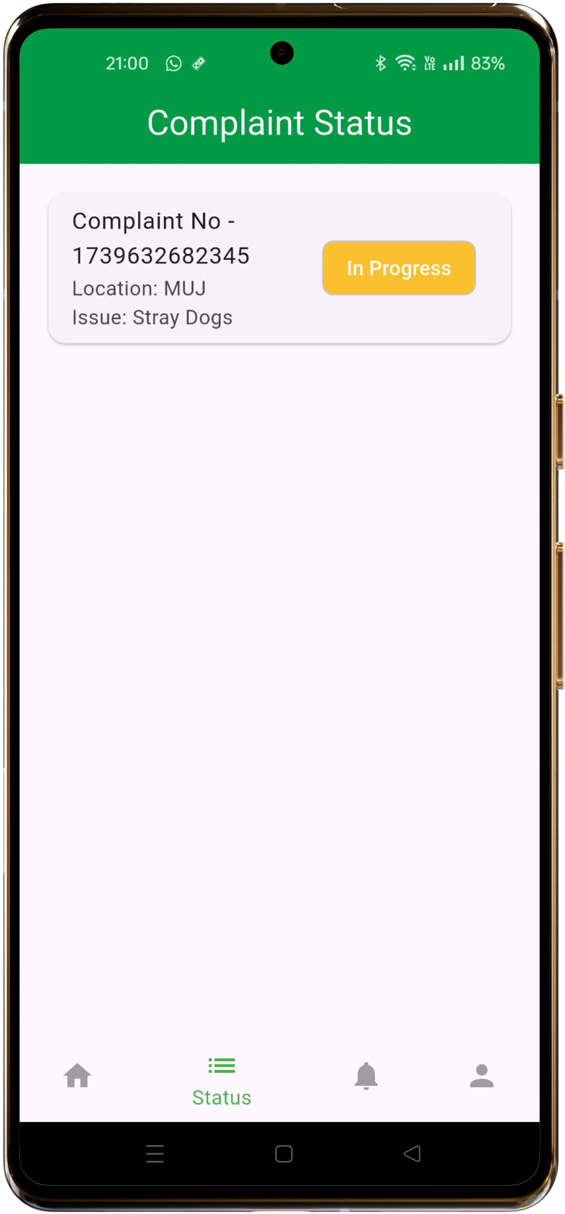
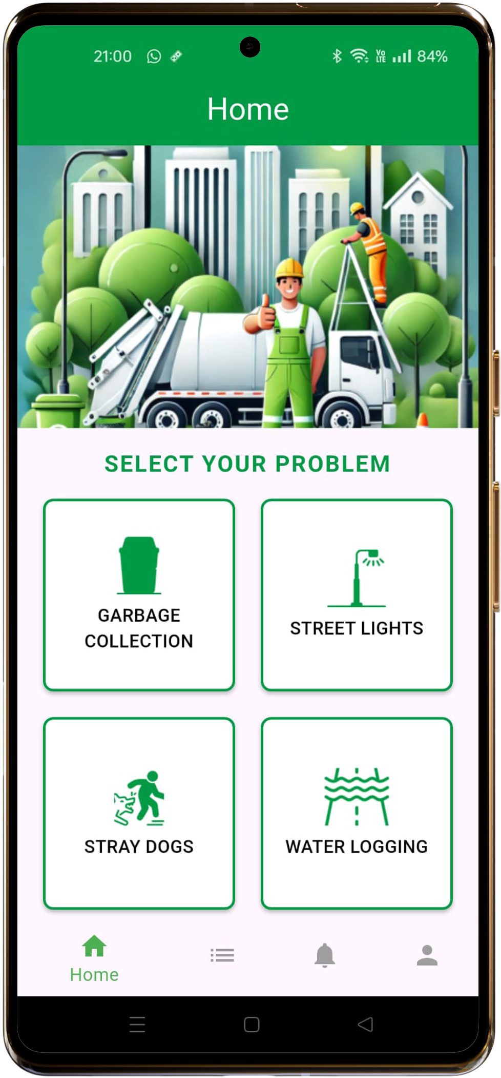
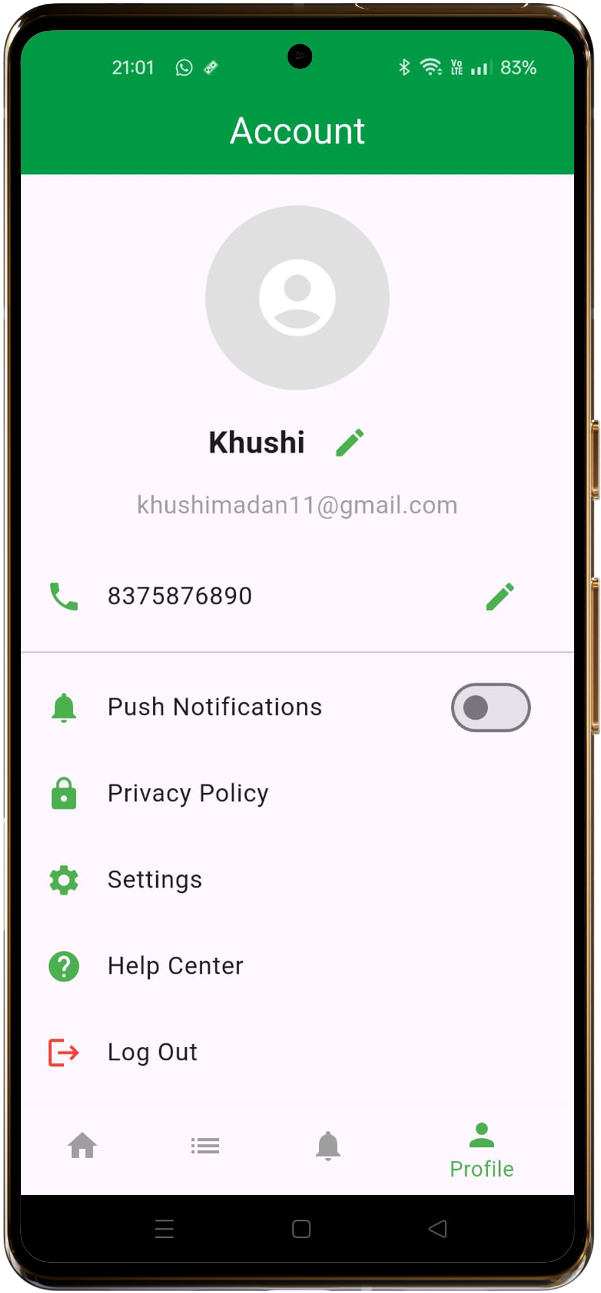
User Screens

Slide 31
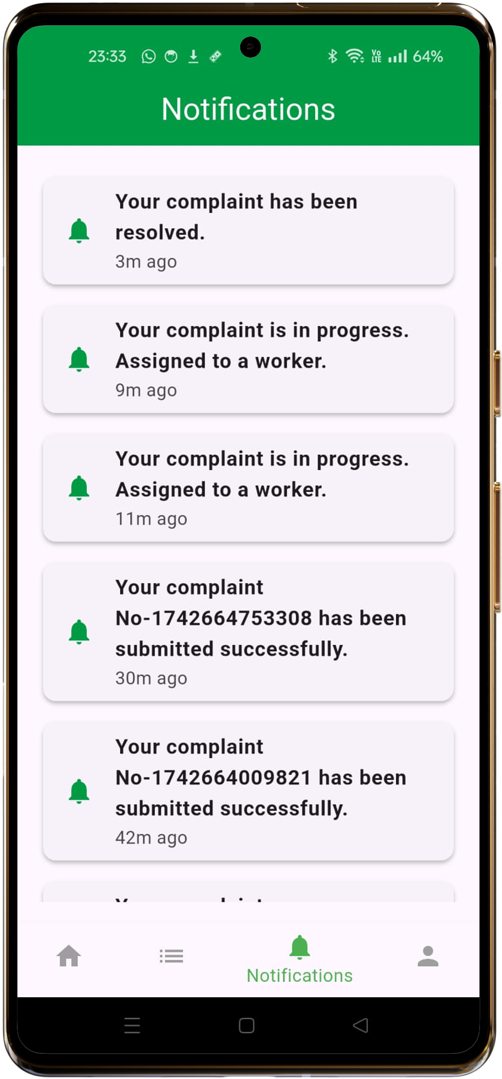
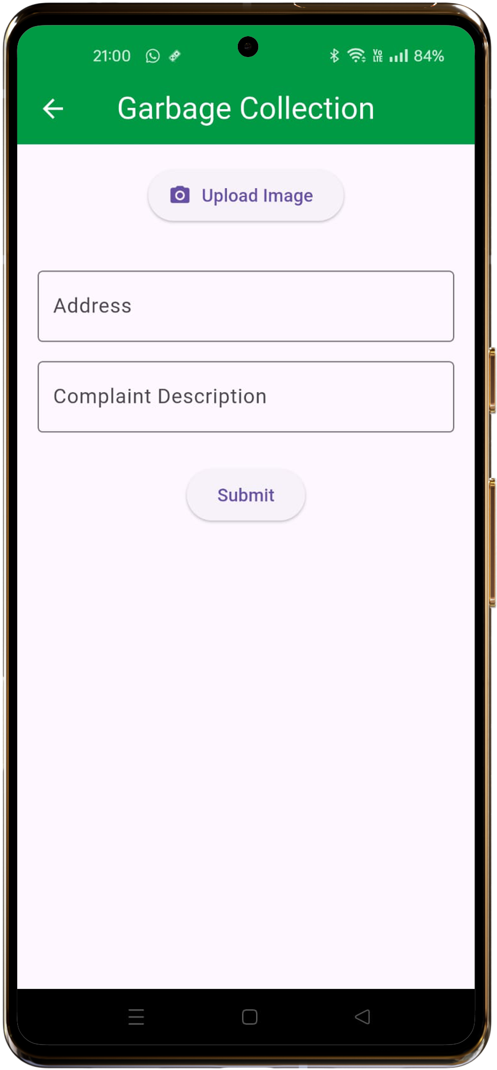
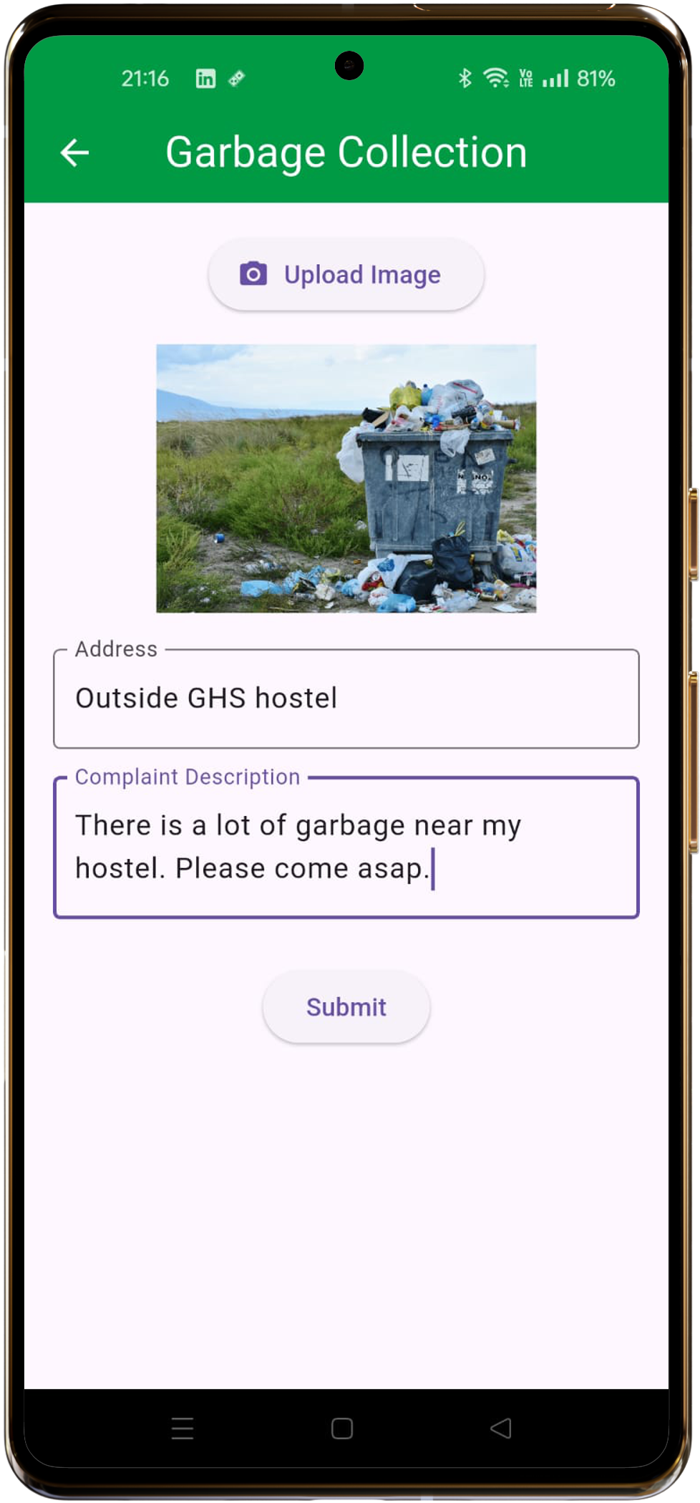
User Screens

Slide 32
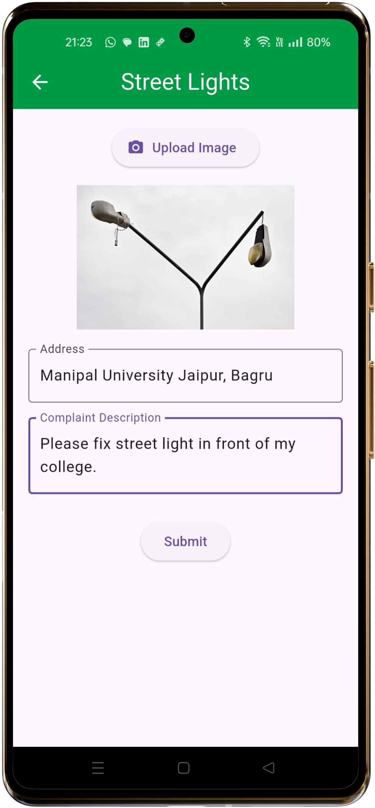
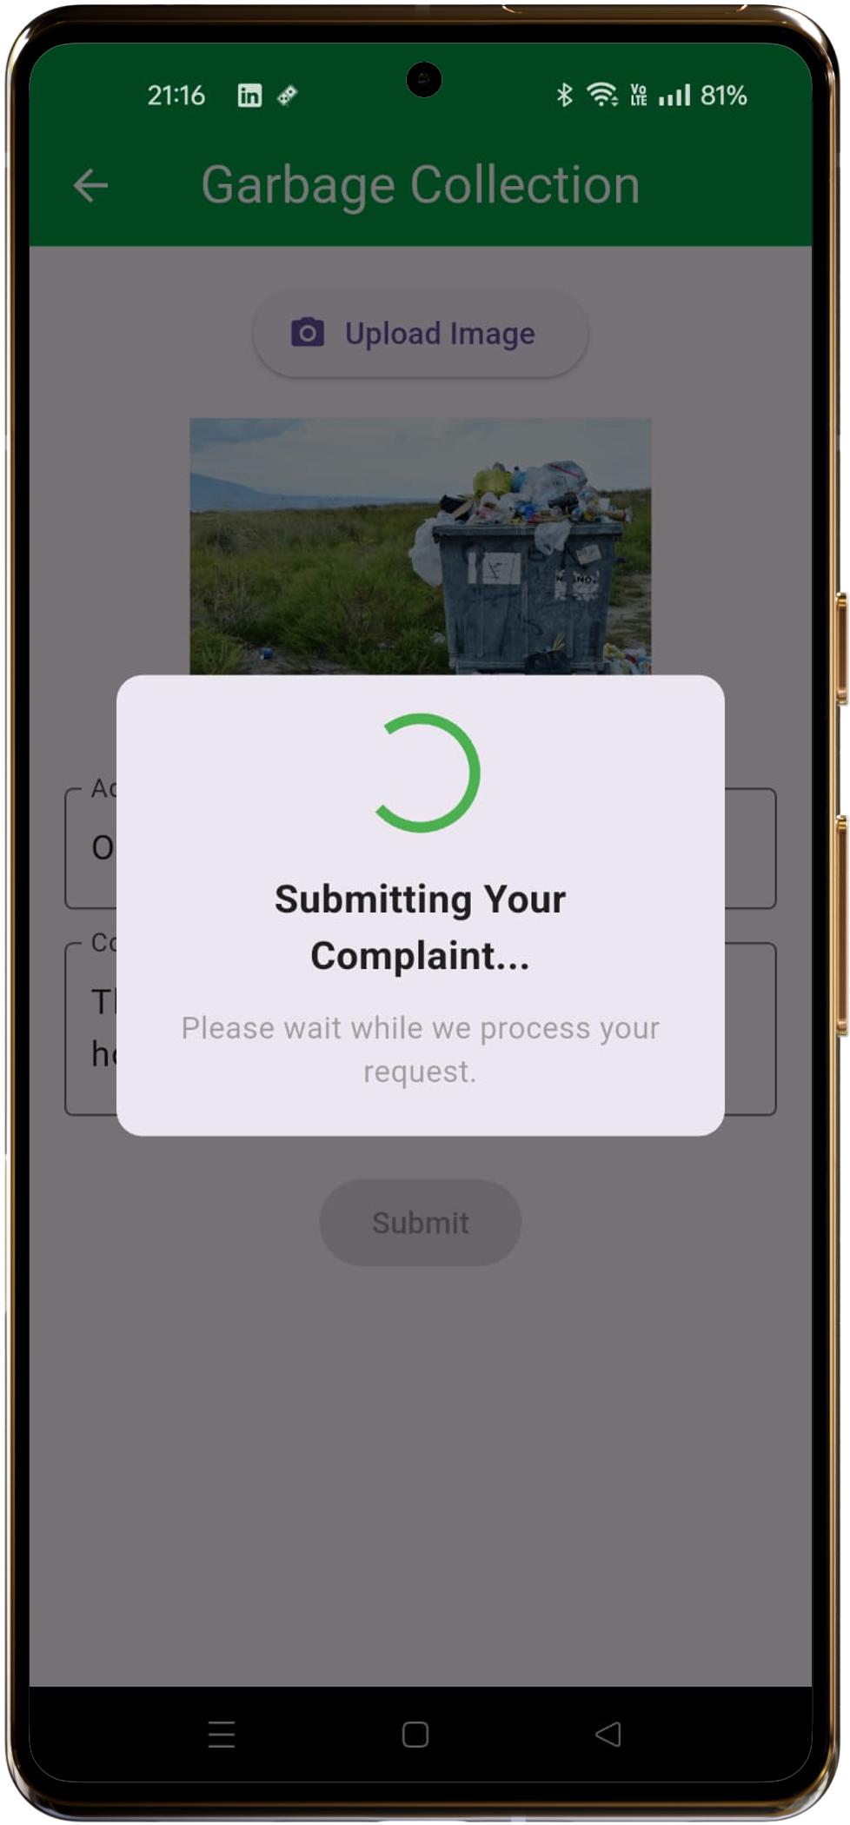
User Screens

Slide 33
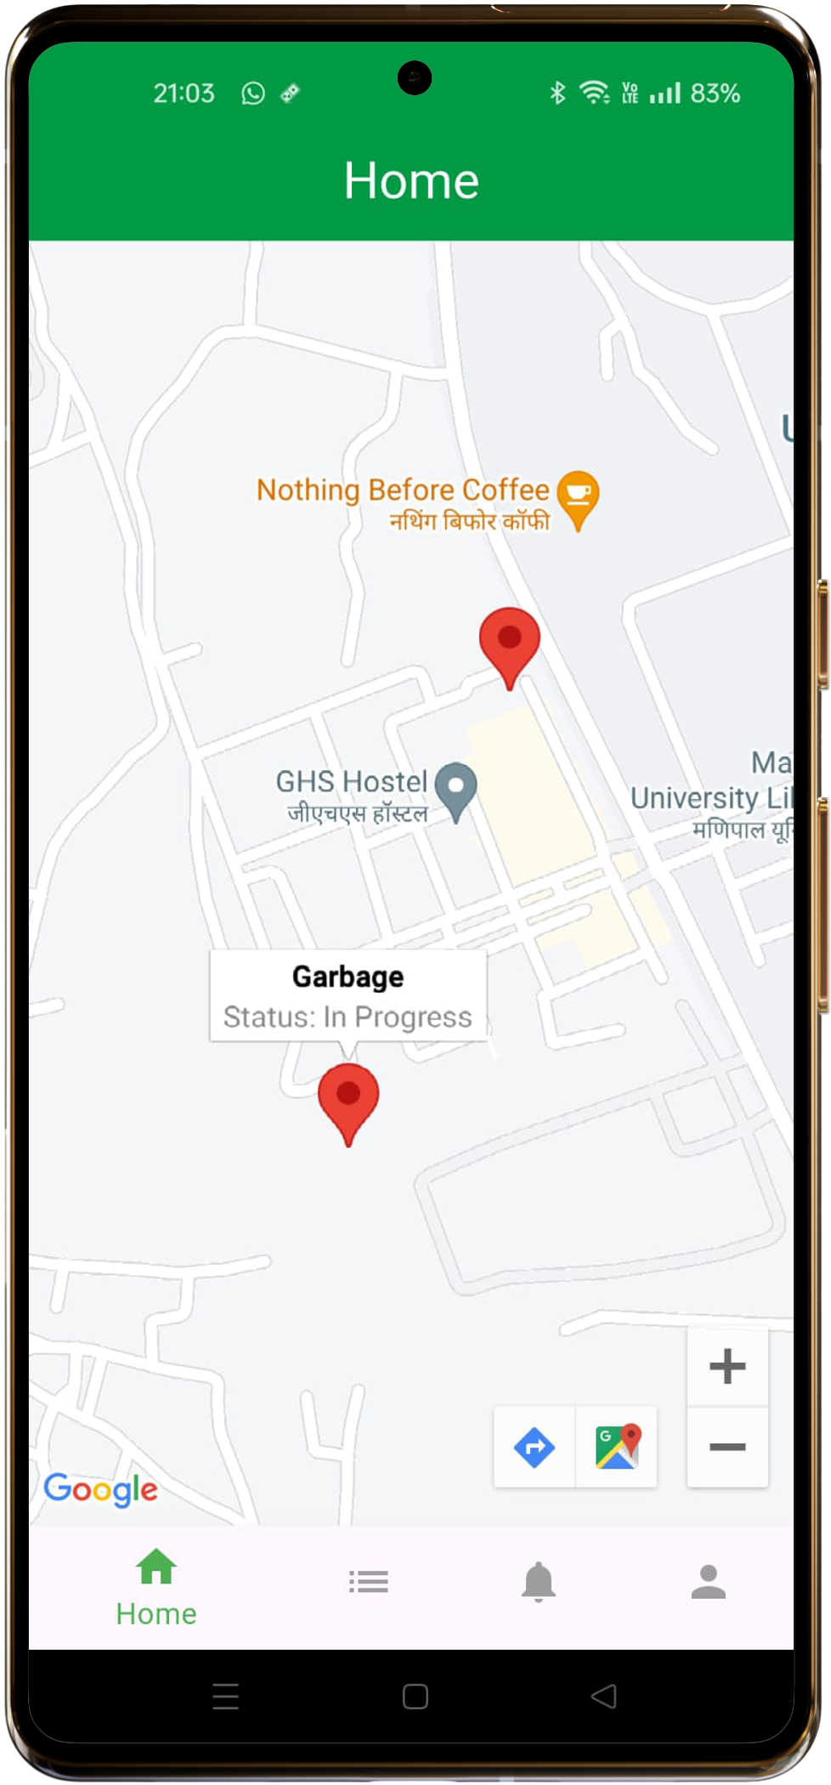
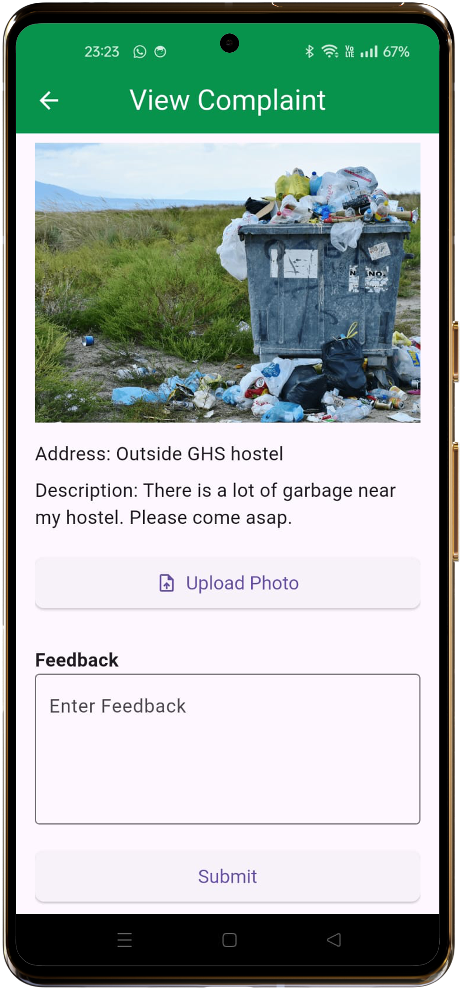
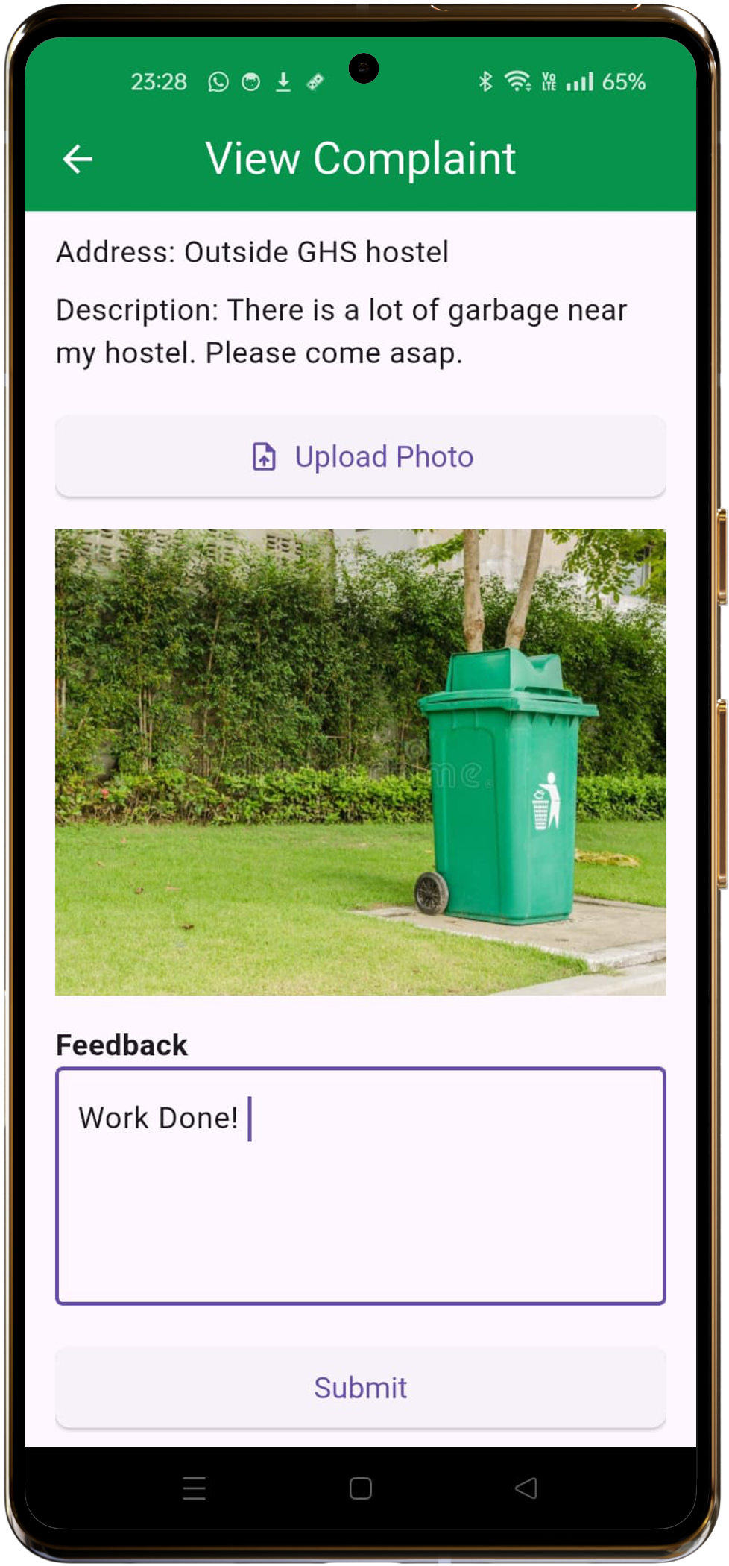
Worker Screens

Slide 34
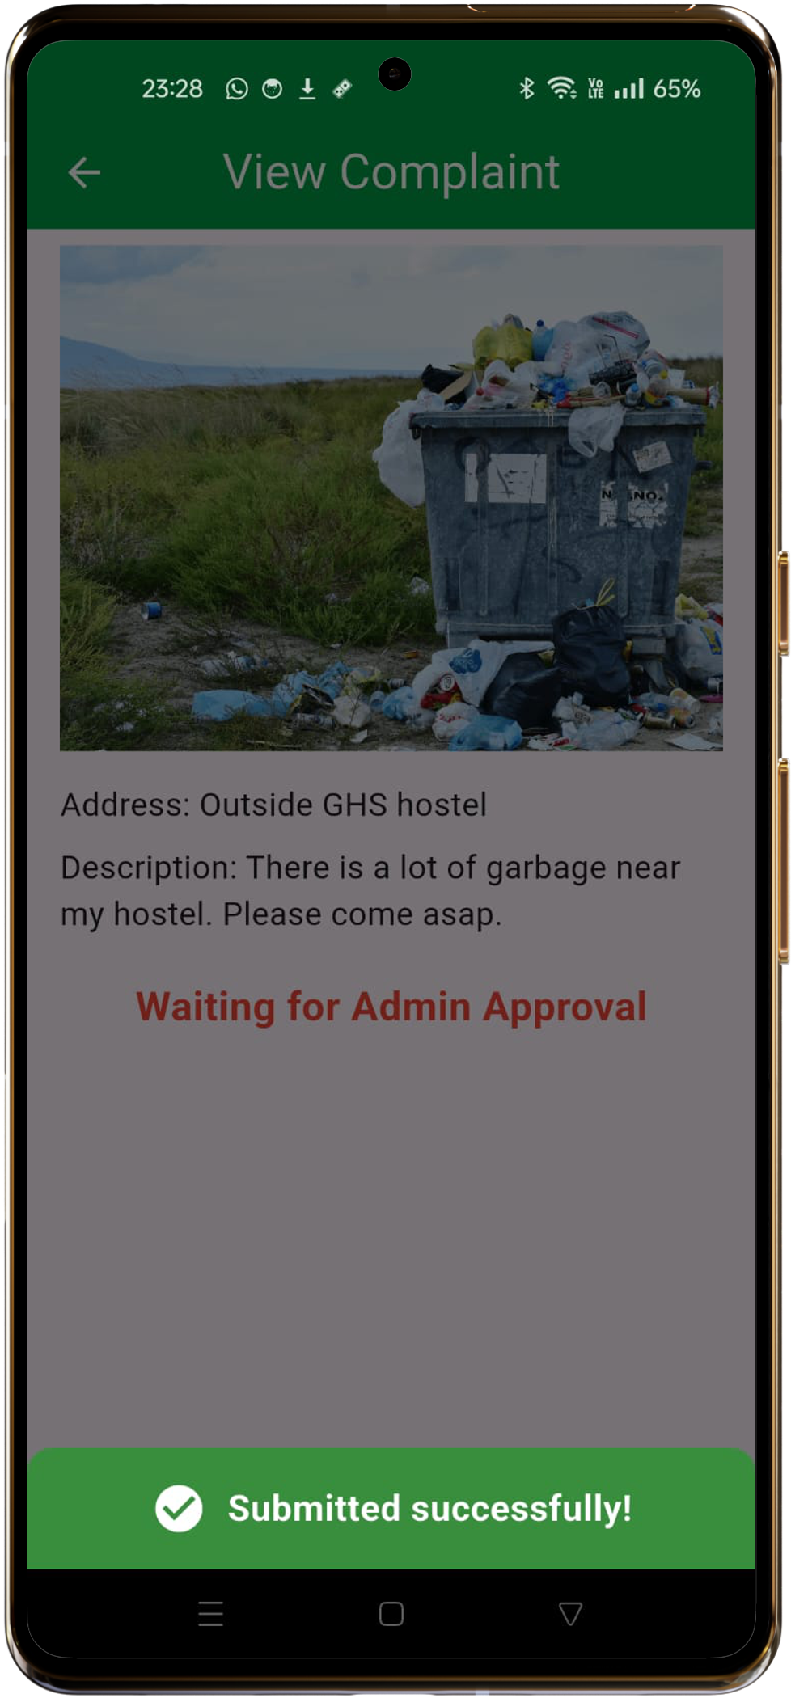
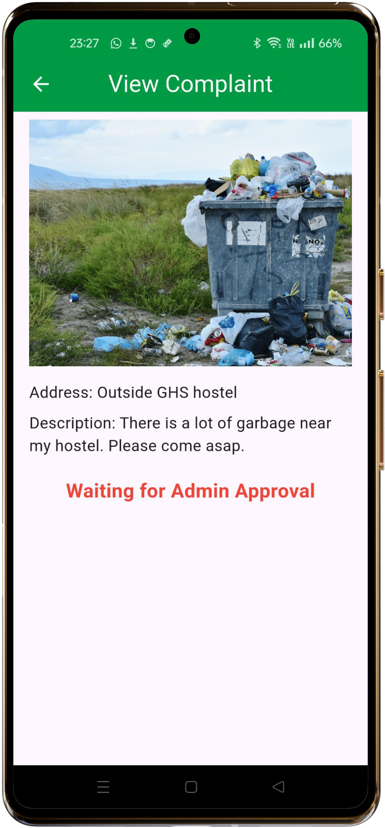
Worker Screens

Slide 35
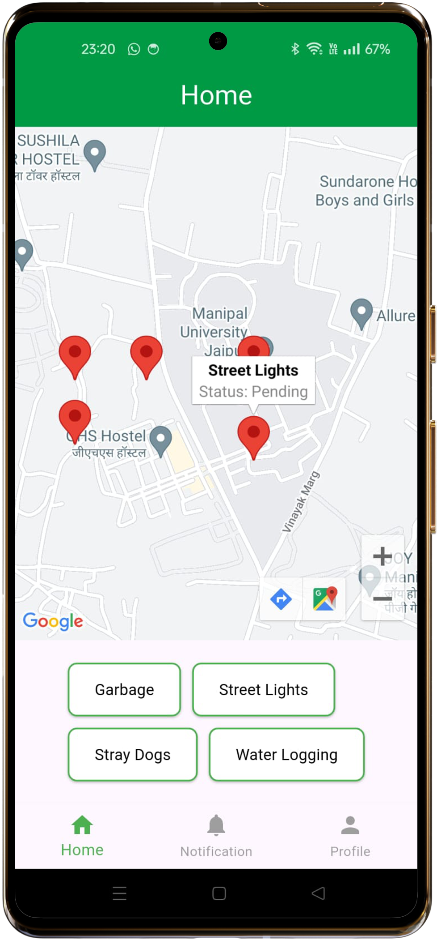
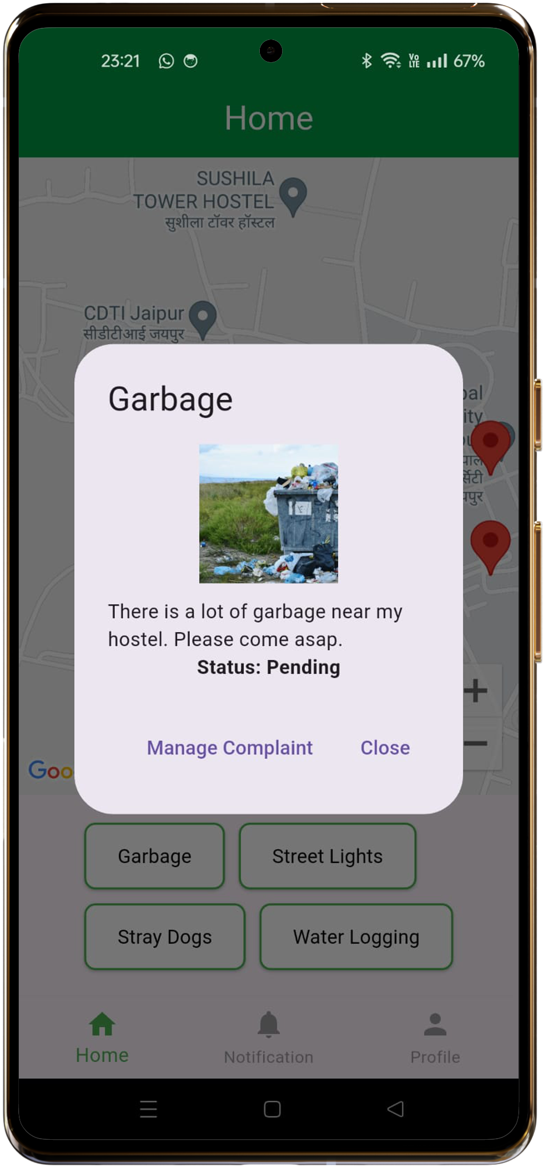
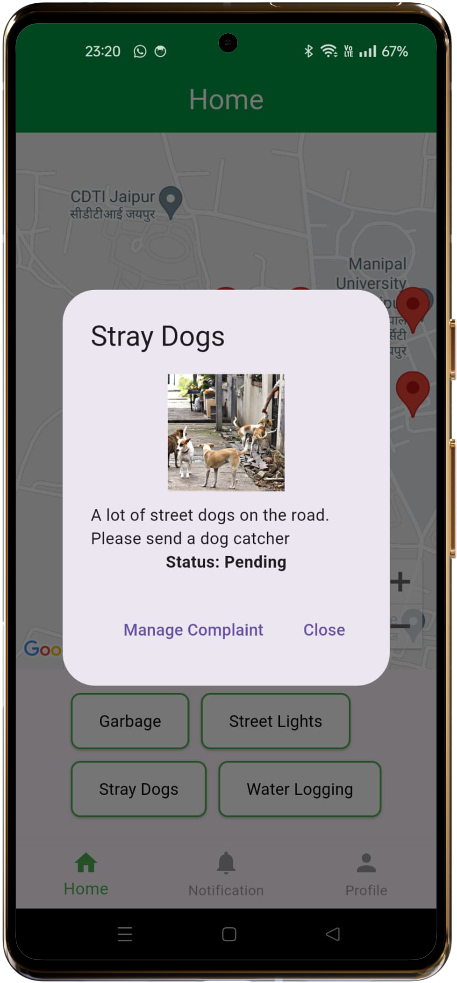
Admin Screens

Slide 36
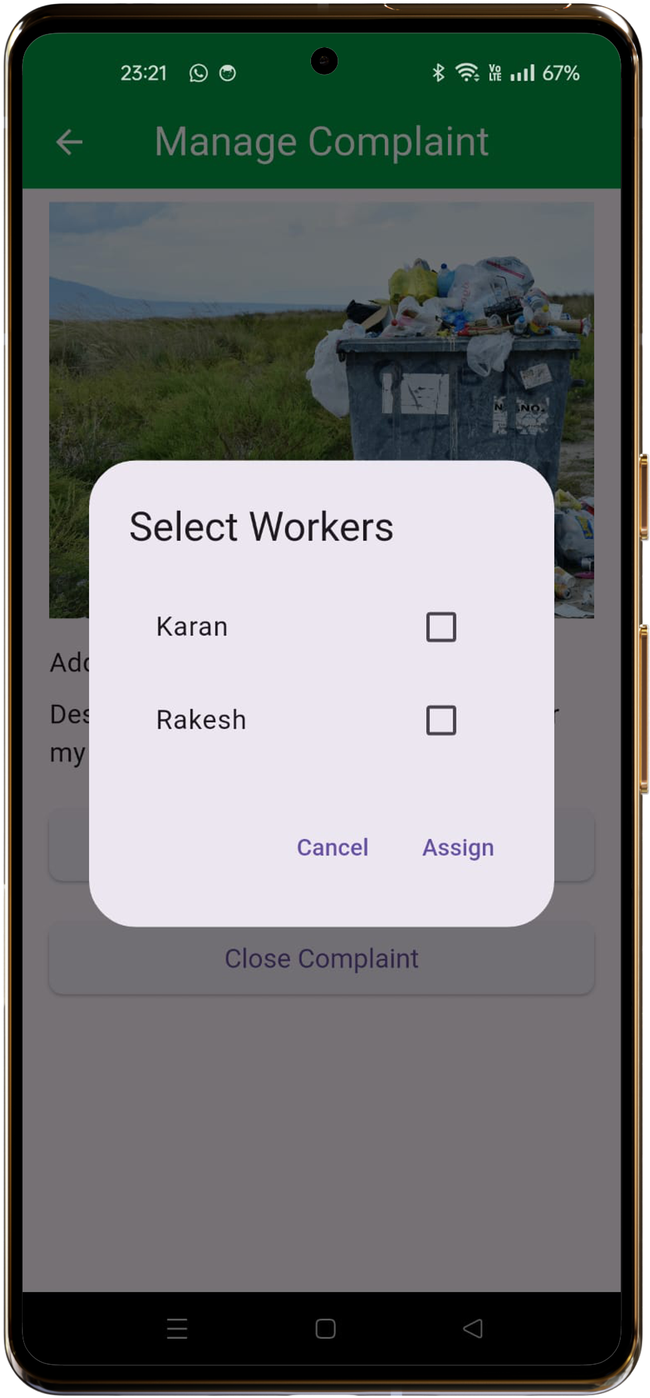
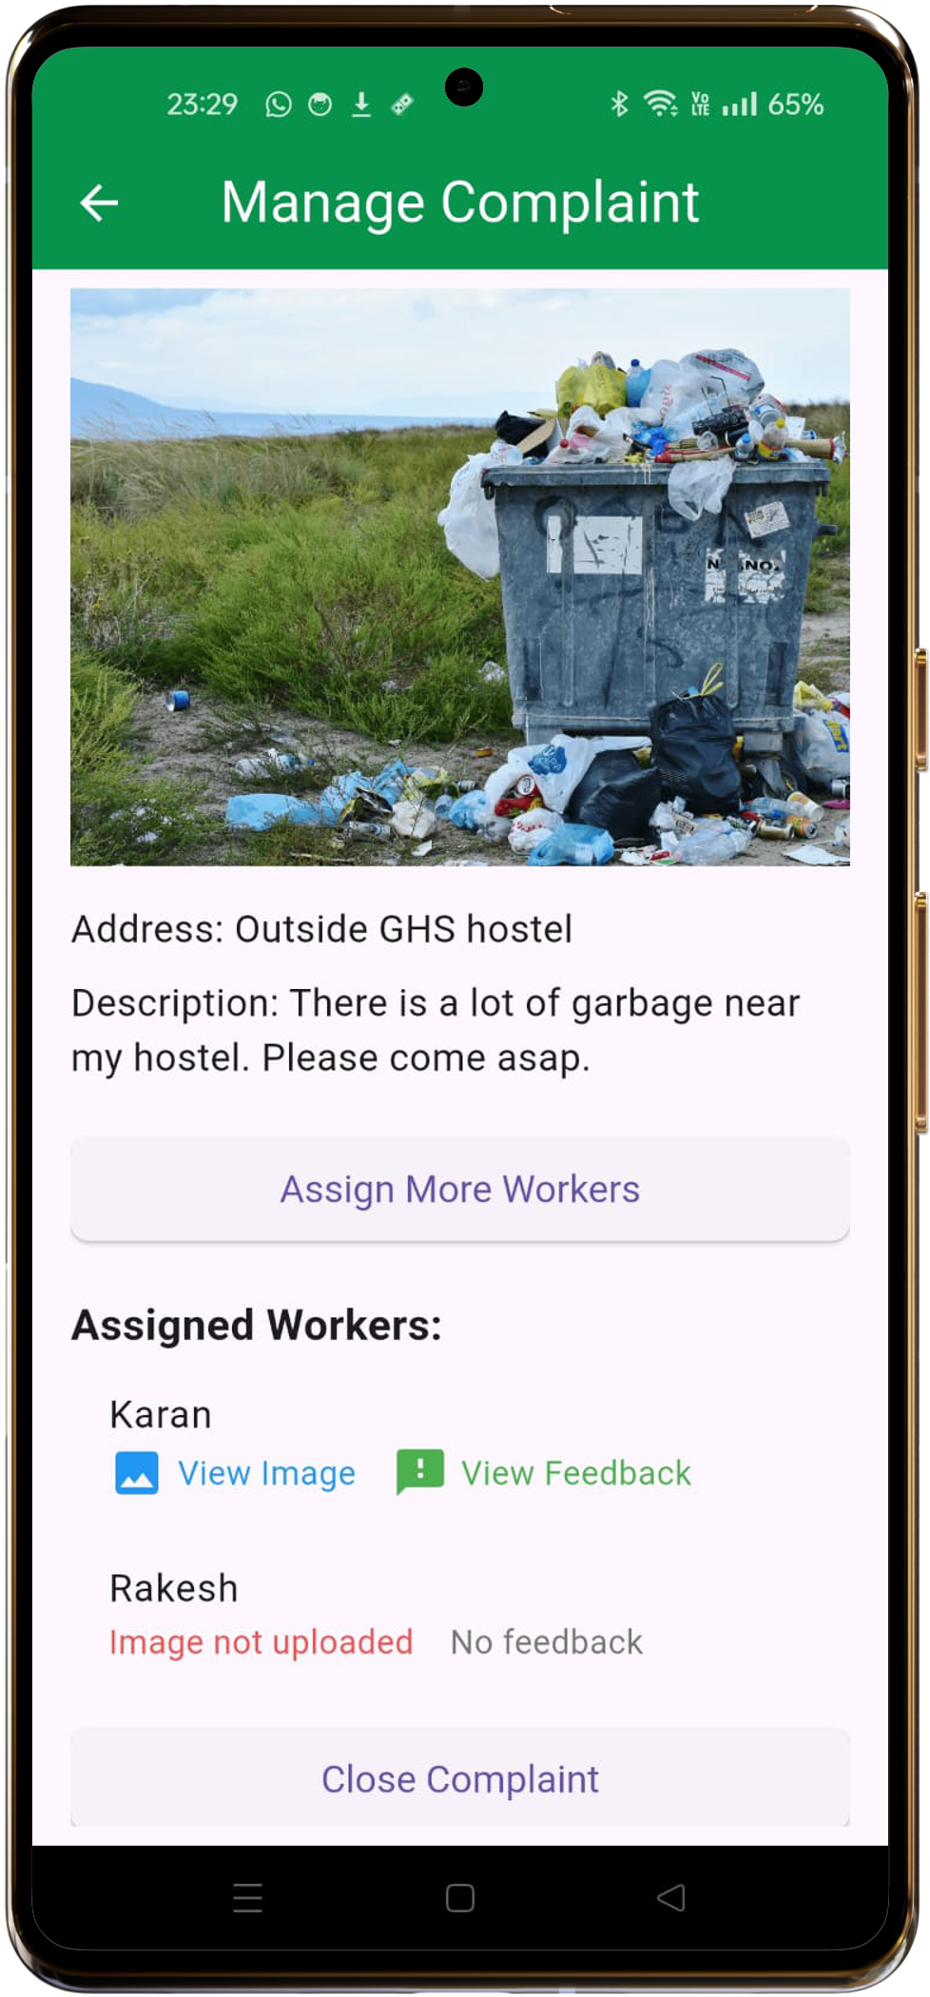
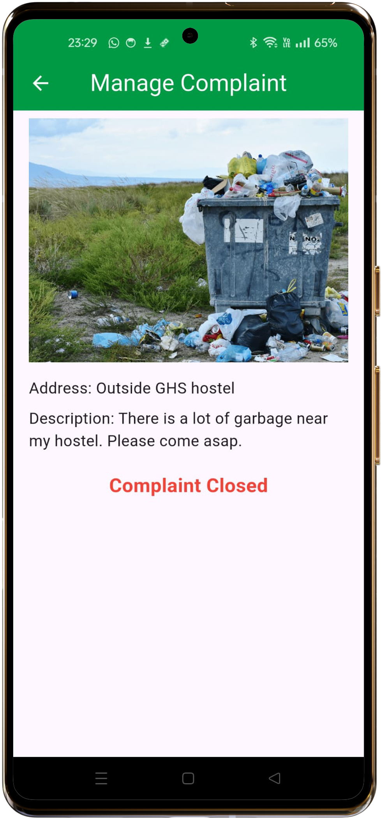
Admin Screens

Slide 37
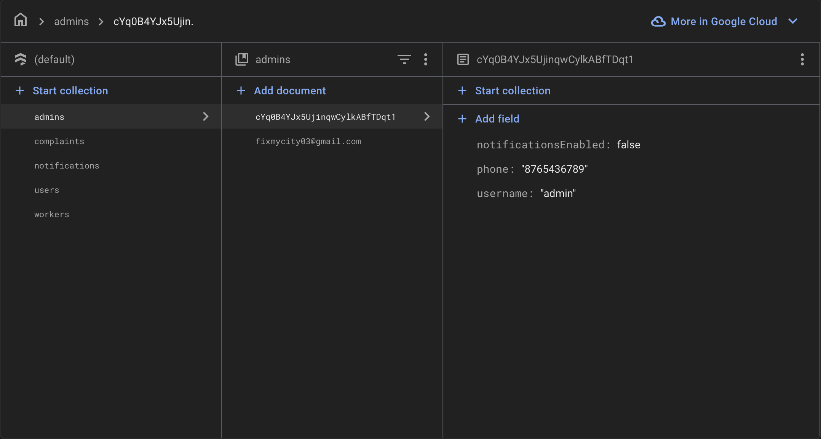
Database Structure (Firestore)

Slide 38
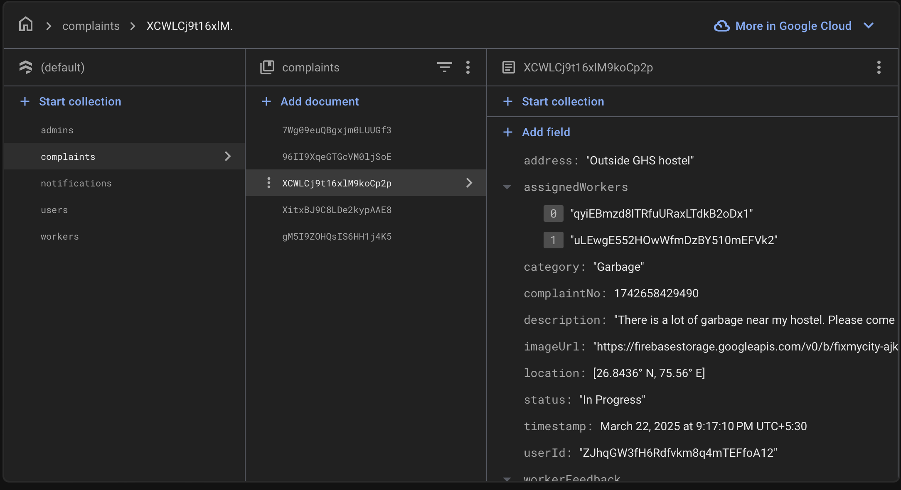
Database Structure (Firestore)

Slide 39
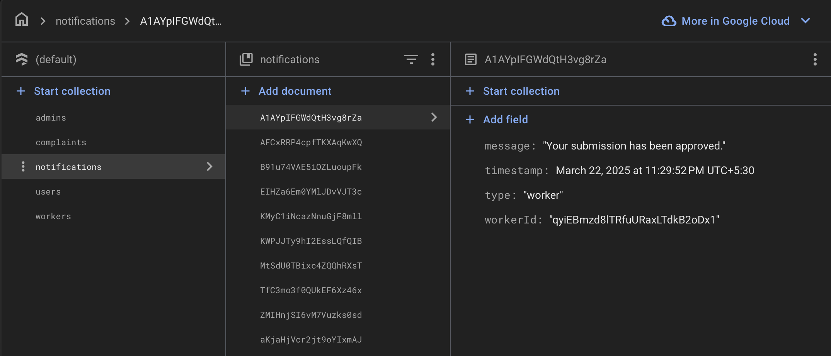
Database Structure (Firestore)

Slide 40
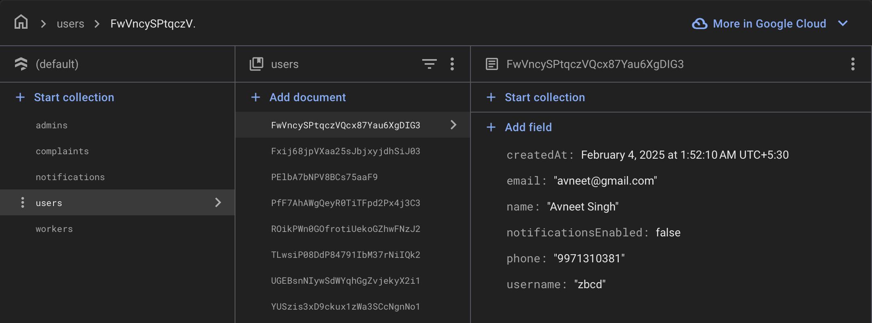
Database Structure (Firestore)

Slide 41
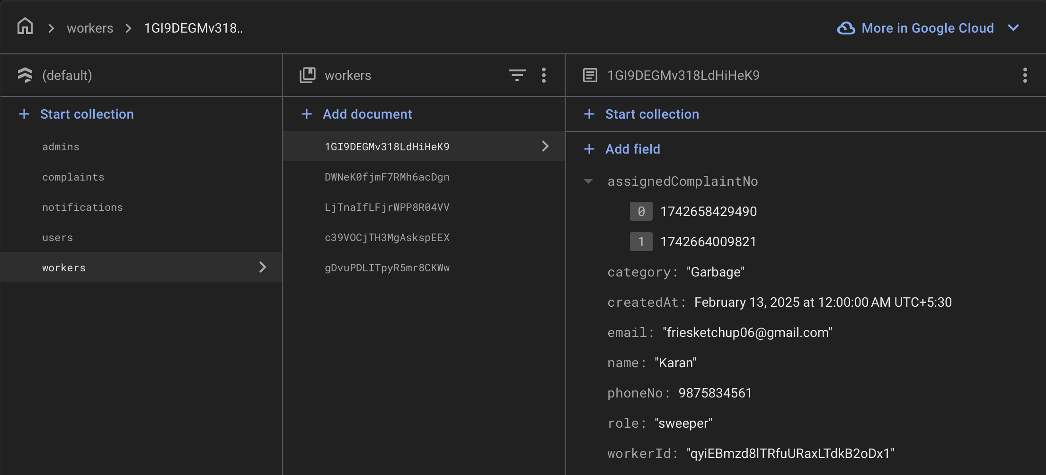
Database Structure (Firestore)

Slide 42
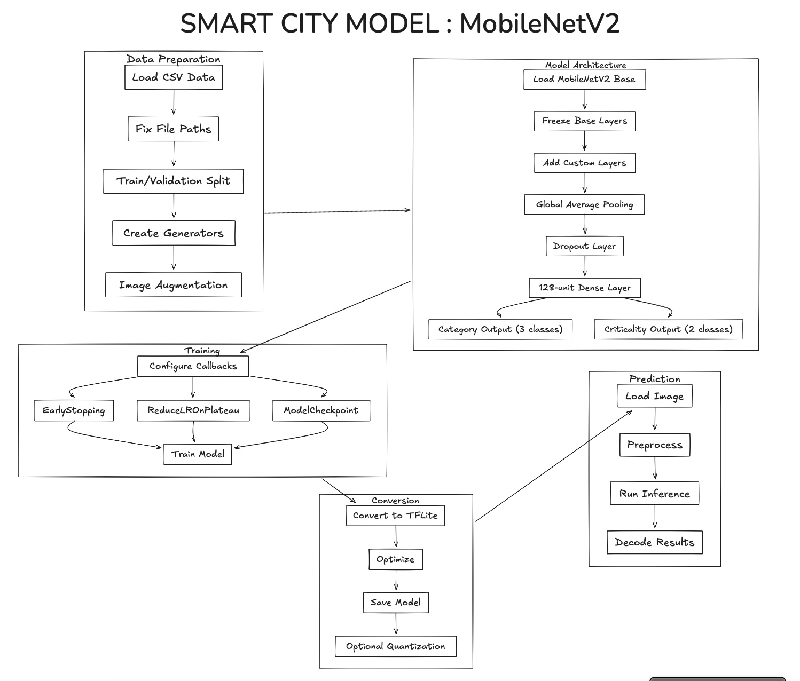
Machine Learning Approach

Slide 43
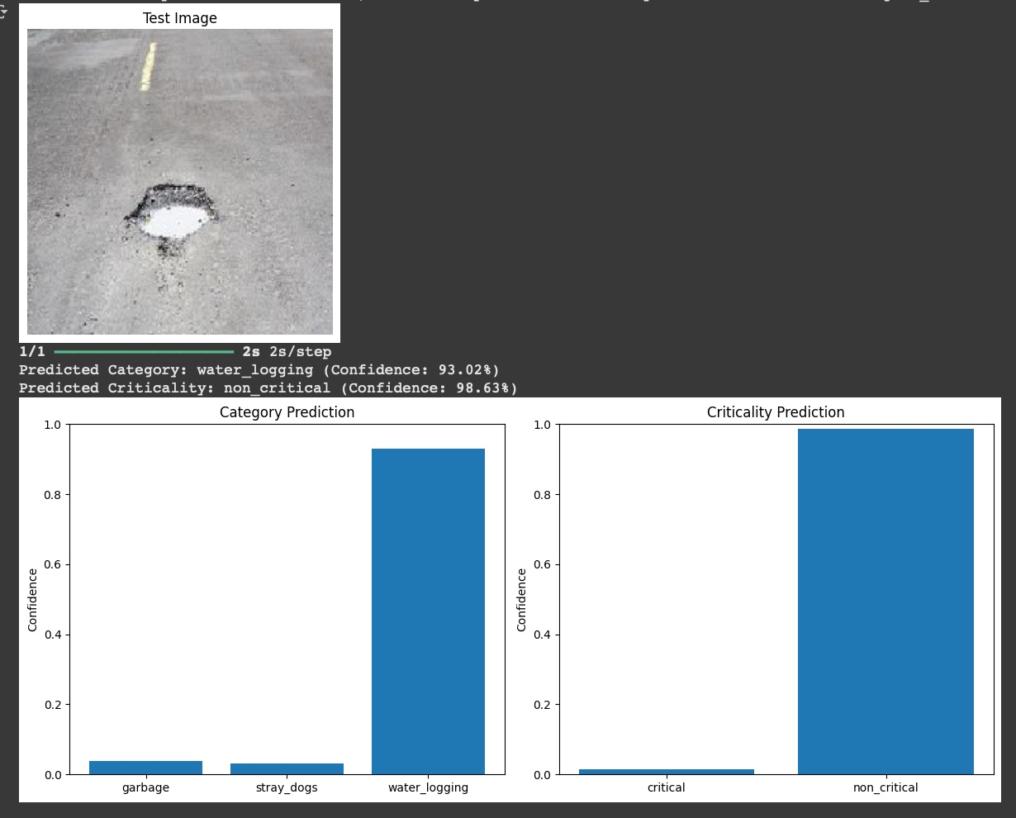
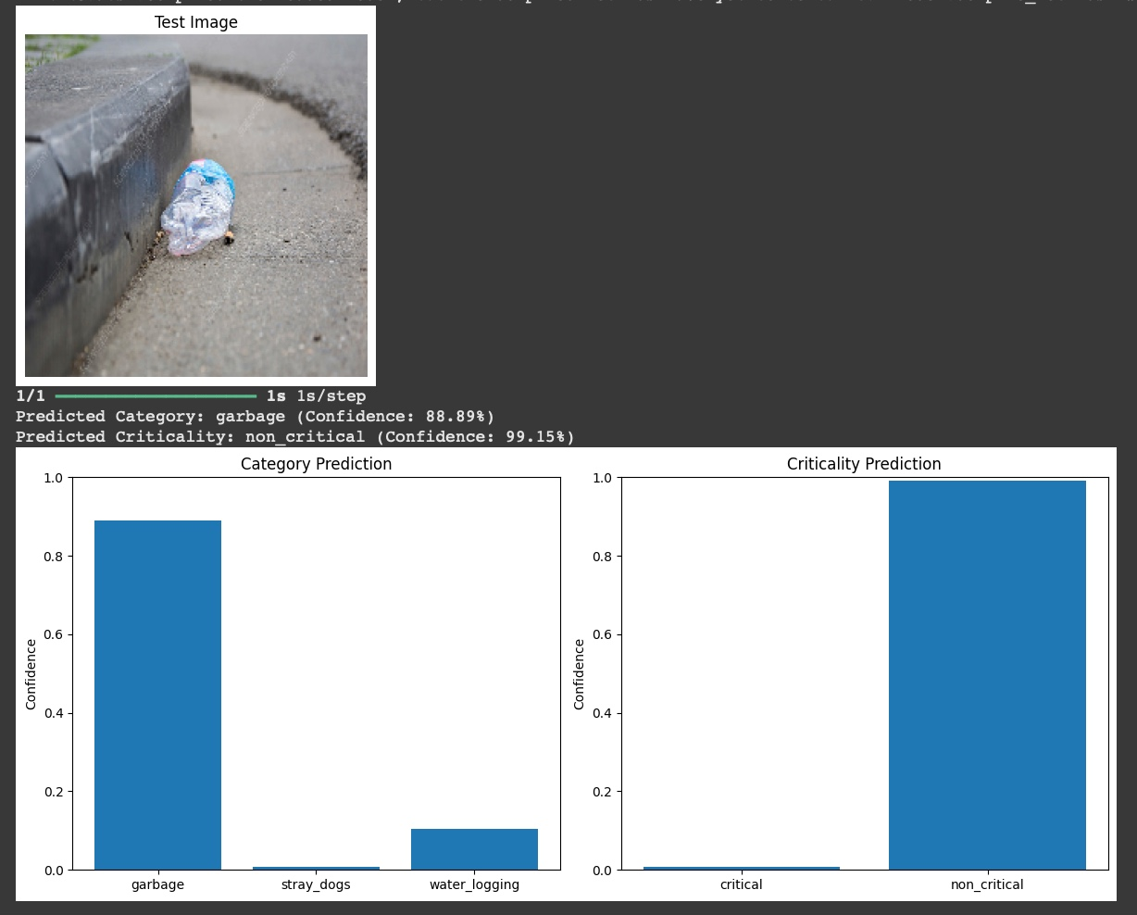
Machine Learning Model (MobileNetV2) Results

Slide 44
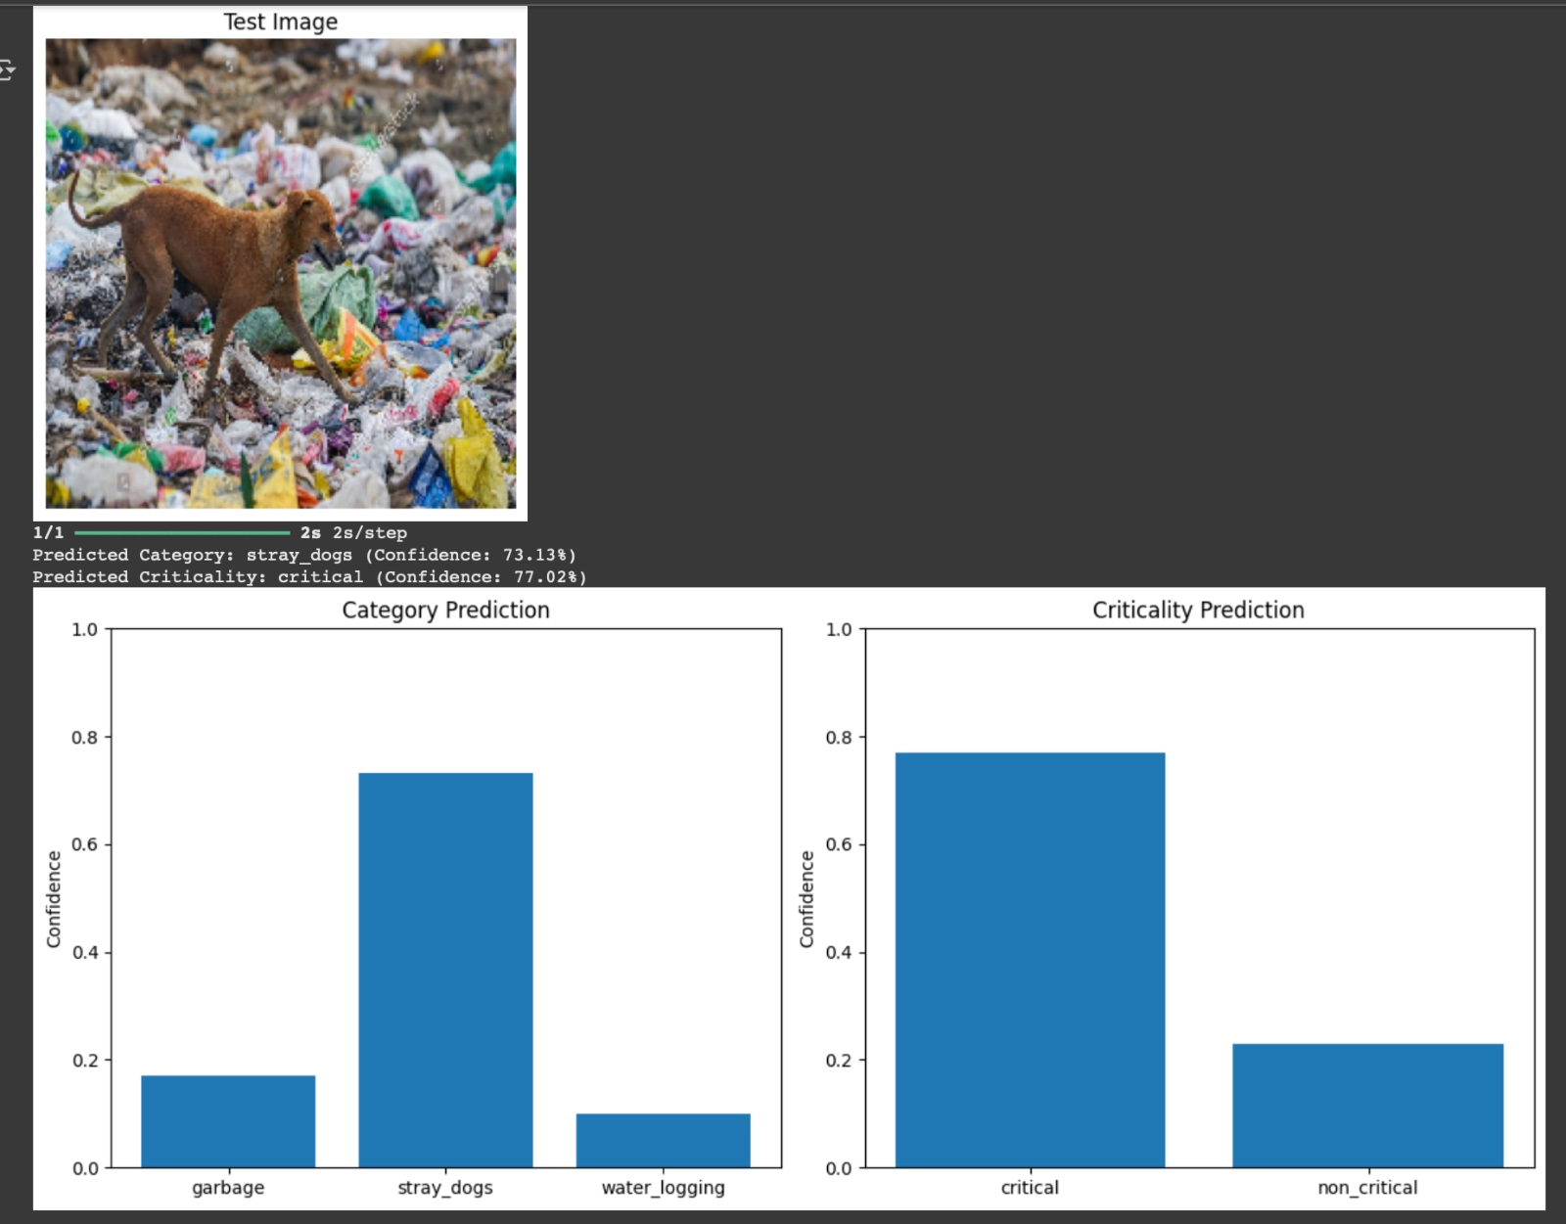
Machine Learning Model (MobileNetV2) Results

Slide 45
Thank You!

